Slide 1
Accessing Public Funding: Opportunities for Rural Missouri
Alyssa Curran, Strategist, MFH - MoCAP Coordinator
Doris Boeckman, Community Asset Builders – MoCAP Consultant
Maile Auterson, Springfield Community Gardens – MoCAP Customer Organization
Notes:
60 minutes

Slide 2
What is MoCAP?
Purpose
Capture funding for Missouri by:
Connecting organizations with grant writing consultation and technical assistance to strengthen their applications for nationally competed federal and private national funding opportunities
Increase orgs' capacity to compete for funding
Approach
Provide grant-writing consultation and TA
Intake, vetting, consultant matching, contract
Feedback, tracking
Notes:
2 minutes: Program of Missouri Foundation for Health since 2010
Goal is to capture more federal and national funding for Missouri organizations by helping Missouri-based nonprofits and governmental health organizations submit stronger applications for federal and nationally-competed private funding opportunities
Monitor funding opportunities ​- Monthly email of opportunities ​
Since 2010, we’ve supported more than 710 proposals, with an overall return on investment of $44 per $1 we put into the program.
To date, over $291 million has been captured for Missouri organizations.
Offers consulting services and technical assistance at no cost to the organization, including: ​
Grant writing services ​
Review and editing support prior to submission​
Technical support in topical areas ​
General grant production support
If open opportunity has been identified: ​(requiring requests to be submitted 5-8 weeks prior to due date)
New customer: Complete Potential customer worksheet - link on MoCAP page of website
Previous customer: Email MoCAP with information on opportunity (name and link) and proposed project, preferred consultant
May have initial Call with MoCAP staff ​(high-level assessment for fit with opportunity guidelines, baseline readiness, federal registrations)
If good fit for opportunity, staff will match with consultant – MFH handles contract and payment
Identify opportunity – types of opportunities (health-related, SDOH, HRSA most often, national foundations, not federal funding that is disseminated by state)
Submit app and we will follow-up
5-8 weeks’ notice
Vetting call – Grants Plus
Match w/consultant – they will work with you on SOW, submit to us to contract with them

Slide 3
Why MoCAP?
Missouri's poor track record
Lack of experience and staff time
Tendency towards competition
More federal funding opportunities
Patient Protection and Affordable Care Act (PPACA)
Notes:
1 min
Lack of federal grant-writing experience and staff time/capacity
A lot of great work happening but that wasn’t translating to federal funding – MO was one of bottom states in public health funding
A lot of new federal funding opportunities came out through ACA
Original goal to pull in more federal funding for Missouri – later expanded to private national funding as well

Slide 4
MoCAP By the Numbers
$50:$1 benefits to cost ratio
$506 million captured for MO
943 proposals supported – 36% successful
MoCAP is in its 16th year – began in 2010
Lifetime statistics (as of Dec 2024) --->
Over 50 MoCAP consultants
Average of 63 contracts/per year (2/org)
~90 total requests - 37% of requests do not become contracts
47% new customer organizations, 53% returning
$10,738/contract on average (increasing)
Average of $33.7 million captured/year
Notes:
3 min
Shifted this – capturing quite a bit of federal funding, more so than other states, this has been noted by federal agencies such as HRSA
MoCAP tracks customer and consultant feedback as well:
The survey reveals overwhelming satisfaction with the MoCAP’s services (most respondents choose the highest rating)
MoCAP plays a critical role in enabling customers to apply for grants and improve the competitiveness of their applications
Respondents praised the expertise, professionalism and high-quality guidance of MoCAP consultants
MoCAP services are seen as a reliable service that generates predicable and critical support and amplifies opportunities for customers
Goal is to capture more federal and national funding for Missouri organizations by helping Missouri-based nonprofits and governmental health organizations submit stronger applications for federal and nationally-competed private funding opportunities
Monitor funding opportunities ​- Monthly email of opportunities ​
Offers consulting services and technical assistance at no cost to the organization, including: ​
Grant writing services ​
Review and editing support prior to submission​
Technical support in topical areas ​
General grant production support
If open opportunity has been identified: ​(requiring requests to be submitted 5-8 weeks prior to due date)
New customer: Complete Potential customer worksheet - link on MoCAP page of website
Previous customer: Email MoCAP with information on opportunity (name and link) and proposed project, preferred consultant
May have initial Call with MoCAP staff ​(high-level assessment for fit with opportunity guidelines, baseline readiness, federal registrations)
If good fit for opportunity, staff will match with consultant – MFH handles contract and payment
Identify opportunity – types of opportunities (health-related, SDOH, HRSA most often, national foundations, not federal funding that is disseminated by state)
Submit app and we will follow-up
5-8 weeks’ notice
Vetting call – Grants Plus
Match w/consultant – they will work with you on SOW, submit to us to contract with them

Slide 5
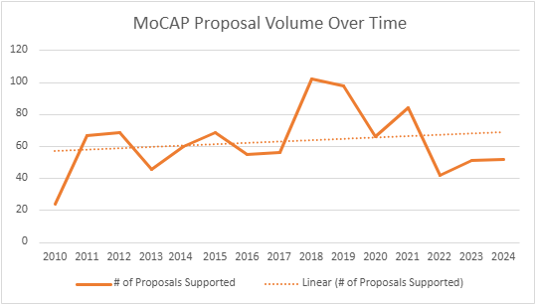
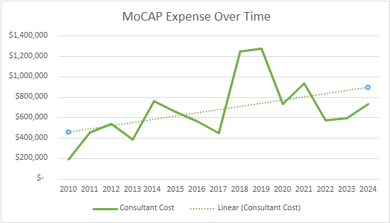
What have we learned?
MoCAP (2020-2024)
Region | # of Contracts | MoCAP Support | Awarded
St. Louis Metro | 132 (46%) | $1,674,300 | $46,545,326
Central | 21 (7%) | $258,850 | $8,149,999
Southwest | 29 (10%) | $242,600 | $5,950,855
Southeast | 24 (8%) | $356,665 | $17,167,813
Northeast | 7 (2%) | $84,700 | $2,199,931
Statewide | 38 (13%) | $741,493 | $125,871,100
Total | 289 | $3,358,608 | $205,885,025
Total Non-Urban | 81 | $942,815 | $33,468,598
% Non-Urban | 28.0% | 28.1% | 16.3%
* Non-urban regions do not include data from 2020 |  | *Non-urban does not include statewide
Notes:
2 min

Slide 6
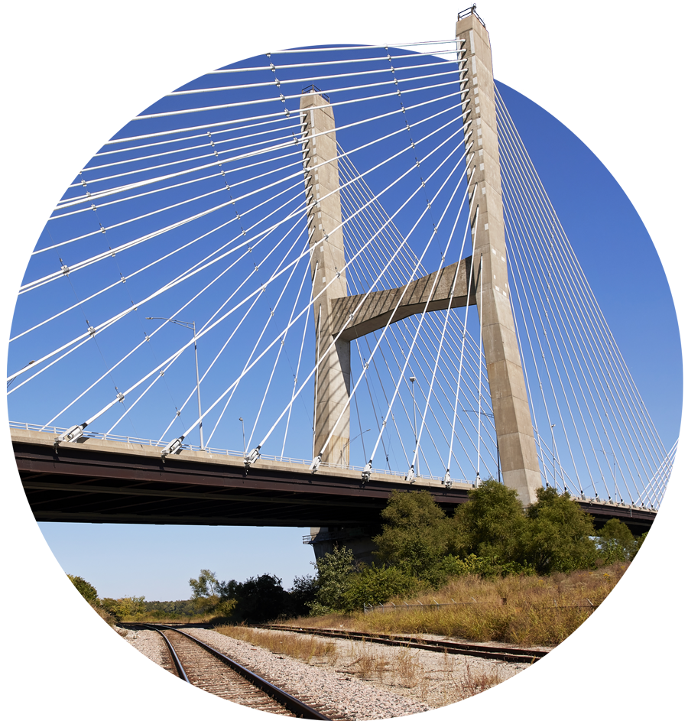
What have we learned?
Trusting relationships w/consultants and customers
Strengthened org competitiveness and capacity
Rural funding successes – HRSA, etc.
Agency reliance on MoCAP
More comprehensive support is needed
Federal funding system flawed and inequitable
MoCAP restructuring for quality improvement
Notes:
2 min (10 min total)
Customer feedback surveys have shown that orgs were more likely to be able to submit funding apps and to submit stronger ones
Public health, rural and state agencies rely on MoCAP
Several types of agencies come back for MoCAP funding, indicating strained capacity/resources – public health agencies, small rural hospitals, state agencies (all kinds of capacity issues/strain and admin red tape)
Solid success in rural specific funding opportunities- there are a number through HRSA we've been very successful with (e.g., rural opioid).
HRSA – Rural Communities Opioid Response Program
HRSA – Rural Health Network Development Planning/Implementation Program, HRSA Delta Health Systems Implementation Program
HRSA – Rural Health Care Services Outreach Program, Rural EMS Training
HRSA – Rural Small Health Care Provider Quality Improvement Program
HRSA - Behavioral Health Service Expansion, School-Based Health Center
USDA – Community Food Projects, Gus Schumacher Nutrition Incentive, Beginning Farmer and Rancher Development, Local Food Promotion Program, Outreach and Assistance for Socially Disadvantaged Farmers and Ranchers
FCC – Affordable Connectivity Outreach
SAMHSA – Rural EMS Training, First Responders Addiction & Recovery Act
DOJ – Rural Domestic Violence, Dating Violence, Sexual Assault and Stalking Program
Perinatal Health – HRSA Healthy Start Initiative, OASH Healthy Families Community-Based Perinatal Health Initiative
Other types of support are needed beyond what MoCAP offers for orgs to be successful in procuring and utilizing federal funding – will get into this in next slide
Some orgs aren’t ready for fed funding and need more support for grant-readiness
Grant-seeking – finding and determining fit
There are several inequities, barriers and administrative burdens posed by the federal funding system (as it was)
Complicated RFAs and app processes, inequitable decision making, reimbursement mechanisms, etc. – CAB can talk more
MoCAP has been in a restructuring process (brought on a consultant team), in process of deeper evaluation
Working to adapt to current environment – some federal funding opps and typical requests will not come through
Target different funding streams and different orgs
Repurpose funding for other supports – targeting national funders, capacity-building for orgs, comprehensive org strength strategies, diversifying funding
Flexibility in working with MoCAP consultants beyond grant-writing for specific funding opp
Help NPOs ready for potential shifts in 2026

Slide 7
What's needed for partner success?
Needs assessment
Funding strategy
Thought partner: connections, resources, strategizing
Grant-seeking/ eligibility
Grant-writing
Matching funds
Collaboration/ community engagement
Equitable design and implementation
Evaluation/ programmatic and financial reporting
Impact, storytelling
Relationships w/funding agencies
Org capacity/ readiness: infrastructure & financial management
Notes:
7 min (15 min total)
Advocacy. Power-building, policy, coalition-building
MoCAP expansion – incorporate needs assessment, allow consultants to incorporate more of this readiness support, funding strategy, thought partnership, collaboration, grant-seeking

Slide 8
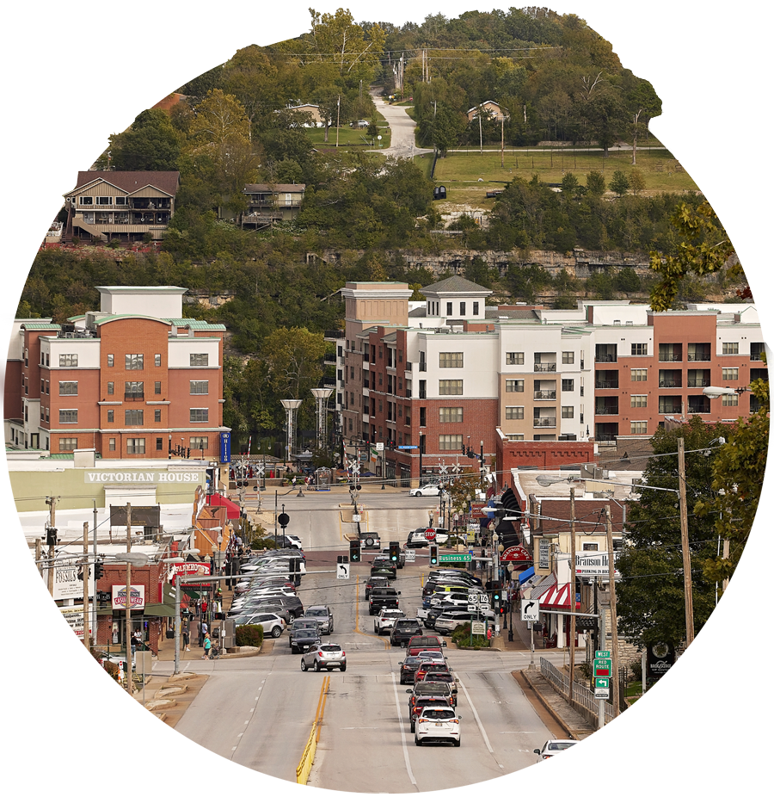
Examples
Similar programs
Nevada GrantLab
Greater Houston United Way Nonprofit Gov Funding Initiative
Missouri Resources
Assel Grant Services Federal Grants Bootcamp
Network for Strong Communities
Missouri Unified Legal and Compliance Hug
YouthBridge Partnership/Merger fund (St. Louis County)
Catchafire
Missouri Rural Development Partners/New Growth
Heartland Regional Food Business Centers
Heartland Environment Justice Center
USDA MO Rural Development Regional Offices
United Ways
National Resources
Grants Plus/Kindsight Grant Writer tool
Environmental Protection Network
Notes:
3 min (20 min total)
Lessons learned – supporting state depts in distributing equitably
Chain that we follow
Narrowly focus our attention
State depts that capture federal funding
DHSS – funding they got from the state – can replicate that
Potential for "Public Funding Hub"
Time for questions at the end
Please hold your questions, note them on a note card

Slide 9
MoCAP Consultant
Doris Boeckman,
Community Asset Builders, LLC
Notes:
ID=d924773e-9a16-4d6d-9803-8cb819e99682 Recipe=text_billboard Type=TextOnly Variant=0 FamilyID=AccentBoxWalbaum_Zero

Slide 10
How it began…
Formed in 2001 by Doris Boeckman and Suzanne Alewine out of a desire to improve access to care.
Grew from two consultants to a team of 25 over the years.
Started with community assessments and planning, which led to resource development, program evaluation, post-award compliance, and more.

Slide 11
CAB Mission and Priorities
MoCAP
Relationship
Our mission is to help others meet their mission.
Our services are diverse.
Our clients are more often rural than not.
Our focus is healthcare – broadly defined – with an emphasis on access to care.
Our priorities are innovation, client success, impact and sustainability.
Our clients are diverse – nonprofits, associations, government, healthcare, EMS, etc.
Initially applying for funding from MFH to support clients.
Engaging in meetings with MoCAP on consultant services.
Serving as a MoCAP consultant – consulting with and writing federal applications for organizations needing assistance.
Relationships with clients are long-term, many have retained services for 15-20 years.

Slide 12
How We Help
Resource development/grant-writing, post-award grant administration/compliance, relationship development, community needs assessment, strategic planning, program evaluation, procurement
Not always easy – there is a lot of organizational prep needed for a first-time federal applicant
Federal systems (UEI, SAM, PMS, post award systems, etc.)
Understanding financial management requirements (budgeting, funds tracking, required documentation, subcontracts, etc.)
Mission-related – don’t chase resources, apply for resources that meet established mission
Need to understand capacity pre- and post-award
It isn’t always just about getting the funding
Partnership endurance
Post-award sustainability
Evaluation

Slide 13
Collaboration to Leverage Grant Resources
Great Mines Health Center
Washington County Ambulance District
Washington County Memorial Hospital
HRSA – School-based Health Center Capital (2018)*
HRSA – Rural Health Care Outreach Program-HRHI (2021)*
HRSA Primary Care Challenge Award (2023)
HRSA Delta Region Community Health Systems Development
Two Rural Community Access to Telehealth Grants (RCAT) (2024)
HRSA Rural Public Health Workforce Training (2022)
HRSA Behavioral Health Expansion (2024)
HRSA Rural Health Care Outreach Program (2025) - PENDING
UnitedHealthcare
SAMHSA-First Responder-Comprehensive Addiction & Recovery*
SAMSHSA EMS Training (2020*,2021*, 2022*, 2023*, 2024, 2025)
Centers for Disease Control- COVID Community Response (2021)*
HRSA Rural Health Network Development for Reynolds County (2023)
RCORP – Behavioral Health*
RCORP – Psychostimulant*
RCORP – Implementation (Rounds 1 and 4)*
*MoCAP funded the application development and submission.
This table only reflects 22 grants (does not include contracts)

Slide 14
Summary of Funding Opportunities/ Awards
Inclusive of CAB-assisted grants/contracts supported by MoCAP
 | # of Applications Submitted | # Awarded | # MoCAP Supported & Funded | # Not Awarded | Percentage Successful
Great Mines Health Center | 12 | 7 | 2 | 4 | 65%
Washington County Ambulance District | 13 | 13 | 5 | 0 | 100%
Washington County Memorial Hospital | 4 | 4 | 4 | 0 | 100%
TOTAL | 28 | 24 | 11* | 4 | 86%
*Totaled $9.5 million in federal funds for grants written between 2019 to 2023. MoCAP support was 1.8% of the total award amount.
*One recent grant is not included for Great Mines Health Center as it is still pending notice of award (or rejection).

Slide 15
MoCAP Value
Applicants
MoCAP
Apprehensive - don’t know what they don’t know
Limited resources and knowledge of what to expect
Funders seek low-risk / high return projects
Applications need to:
Reflect capacity and ability
Communicate post-award capacity
Elaborate on post-grant sustainability
Link to grant-writer(s) with subject matter expertise
Increases chance for a successful (funded) application
Connects potential applicants to consultants who can connect them to other funded programs to gain better understanding of grant expectations
Consultant funding allows for consultants to coach / educate on grant development while assisting with writing

Slide 16
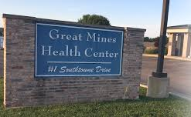
Case Study: Great Mines Health Center
FQHC, formed in 2003
Located in Potosi, MO
Serves St. Francois and Washington Counties
Socio-economically disadvantaged area with limited resources
Underserved populations with poor health outcomes and many access barriers
Partnered with CAB in 2018
Local Partnership: hospital, health center, ambulance district, health department and community partnership

Slide 17
MIH Network Growth
CAB is also a co-founding partner of The Mobile Integrated Healthcare Network® dba Sho-Me MIH Network.
This nonprofit is focused on expanding a new healthcare delivery model in Missouri, particularly rural Missouri.
Mobile Integrated Healthcare (MIH) provides the right care in the right place at the right time with community paramedics serving as physician extenders. The model increases access to care while lowering overall costs to the healthcare system. www.mihnetwork.org
MoCAP has supported an additional 9 MIH-related applications (2022-2024). 78% were awarded for a total of $6.6 million (MoCAP = 1% of award amount)

Slide 18
CAB’s MIH / Association Management Team
Doris Boeckman
Co-Founder/ Executive
Felisha Richards
Senior Strategist
Shelby Cox
Senor EMS Consultant
Sandy Kempker
Finance/ Membership Manager

Slide 19
Thank you
Doris Boeckman, Co-Founder/Executive
doris@cabllc.com
www.cabllc.com

Slide 20
MoCAP Customer Organization
Maile Auterson,
Springfield Community Gardens
Notes:
10 min
Maile Auterson, Springfield Community Gardens
Service region
Mission/work
Received MoCAP support for several USDA funding opportunities
Detail which funding opps
Successes, impact
Challenges
Lessons learned, needs/opportunities

Slide 21
Strategy Discussion
Questions?
How can we fill the gaps in the changing environment?
What supports currently exist?
What needs to be developed? What should be prioritized?
How can these be supported? How can your foundation contribute?
What are the next steps to move forward with these priorities?
Notes:
20 min - Note cards – write questions and answers to these questions
10 min questions (for me, CAB, SCG)
10 min discussion/brainstorming
Sticky notes on white board or write thoughts on note cards in case there isn’t time for all questions/comments or you don’t want to share with the whole group

Slide 22
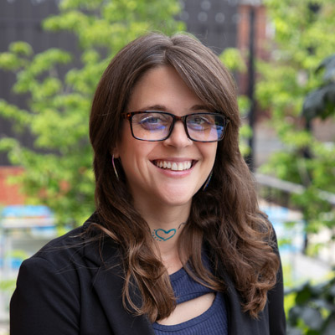
Questions?
Alyssa Curran
Strategist – Responsive Philanthropy
acurran@mffh.org
MoCAP Inquiries:
MoCAP webpage
mocap@mffh.org

