Slide 1
When Resilience Isn't Enough: Building Shared Infrastructure for Rural Health
Libby Trammell, LCSW

Slide 2
Missouri Rural Health Association
Providing leadership on rural priorities through advocacy, education, and collaboration
Advocacy- Legislative lobbying and expert testimony
Education- Webinars and Conferences
Collaboration- Rural stakeholders including: Healthcare providers, public health professionals, community organizations, and policy leaders

Slide 3
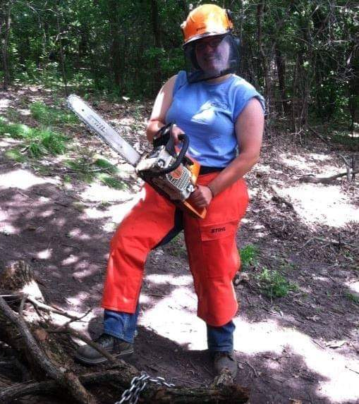
Libby Trammell
Originally from South Dakota
Licensed Clinical Social Worker (LCSW)
Community & Digital Advocacy Manager at MRHA
Co-Author of 2026 Needs Assessment
Background in advocacy, case management, and community organizing

Slide 4
2026 Needs Assessment
This was the 2nd Needs Assessment completed by MRHA, the first was published in 2023
  2023 Needs Assessment highlighted declining health and increased death rates in Rural Missouri
2026 Needs Assessment
  Found that every indicator of health was worse in rural areas than in urban with 1 exception (Air quality)
  Cancer rates, asthma, childhood poverty, and chronic respiratory diseases all occur more frequently in rural areas than urban

Slide 5
Rural Missouri Statistics
Disparate mortality
  40% higher for rural residents than their urban counterparts with a sharp spike in deaths from 2020-2022
Disproportionate Early Death in Rural vs. Urban MO
  Heart disease: 19% higher
  Cancer: 13% higher
  Chronic lower respiratory disease: 16% higher
  What do you think is the leading cause of death for 18-44 year olds in Missouri?
    80% of the counties most impacted by this cause of death are rural

Slide 6
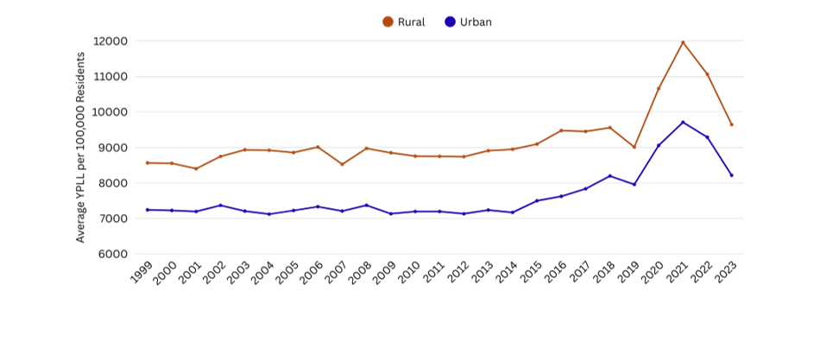
Years of Potential Life Lost

Slide 7
Racial Disparities
Black Missouri residents experience the harshest health disparities which reduces overall life expectancy
  Double the poverty rate than their white counterparts
  Black infants experience 3x the mortality rate of white infants
  High rates of chronic illness, hospitalization, and premature death
  Black men face significantly higher fatal ODs than their white counterparts
This has several causes including:
  Bias and discrimination on the micro level
  Systems-level racism
  Lack of culturally competent care
  Many more factors

Slide 8
Further Considerations for Rural Health
Preventative Care Access
Delayed screenings, diagnosis, and treatment leads to worse health outcomes
High-Risk Behavior
Consider: If it is easier to access your drug of choice than it is to access a doctor's care, which would you reach for to treat your health issue?
Lack of culturally appropriate care
Patients often prefer healthcare staff with a shared identity to them
Provider familiarity with rural life is key to quality care (Example: Exposure to chemicals in agriculture)

Slide 9
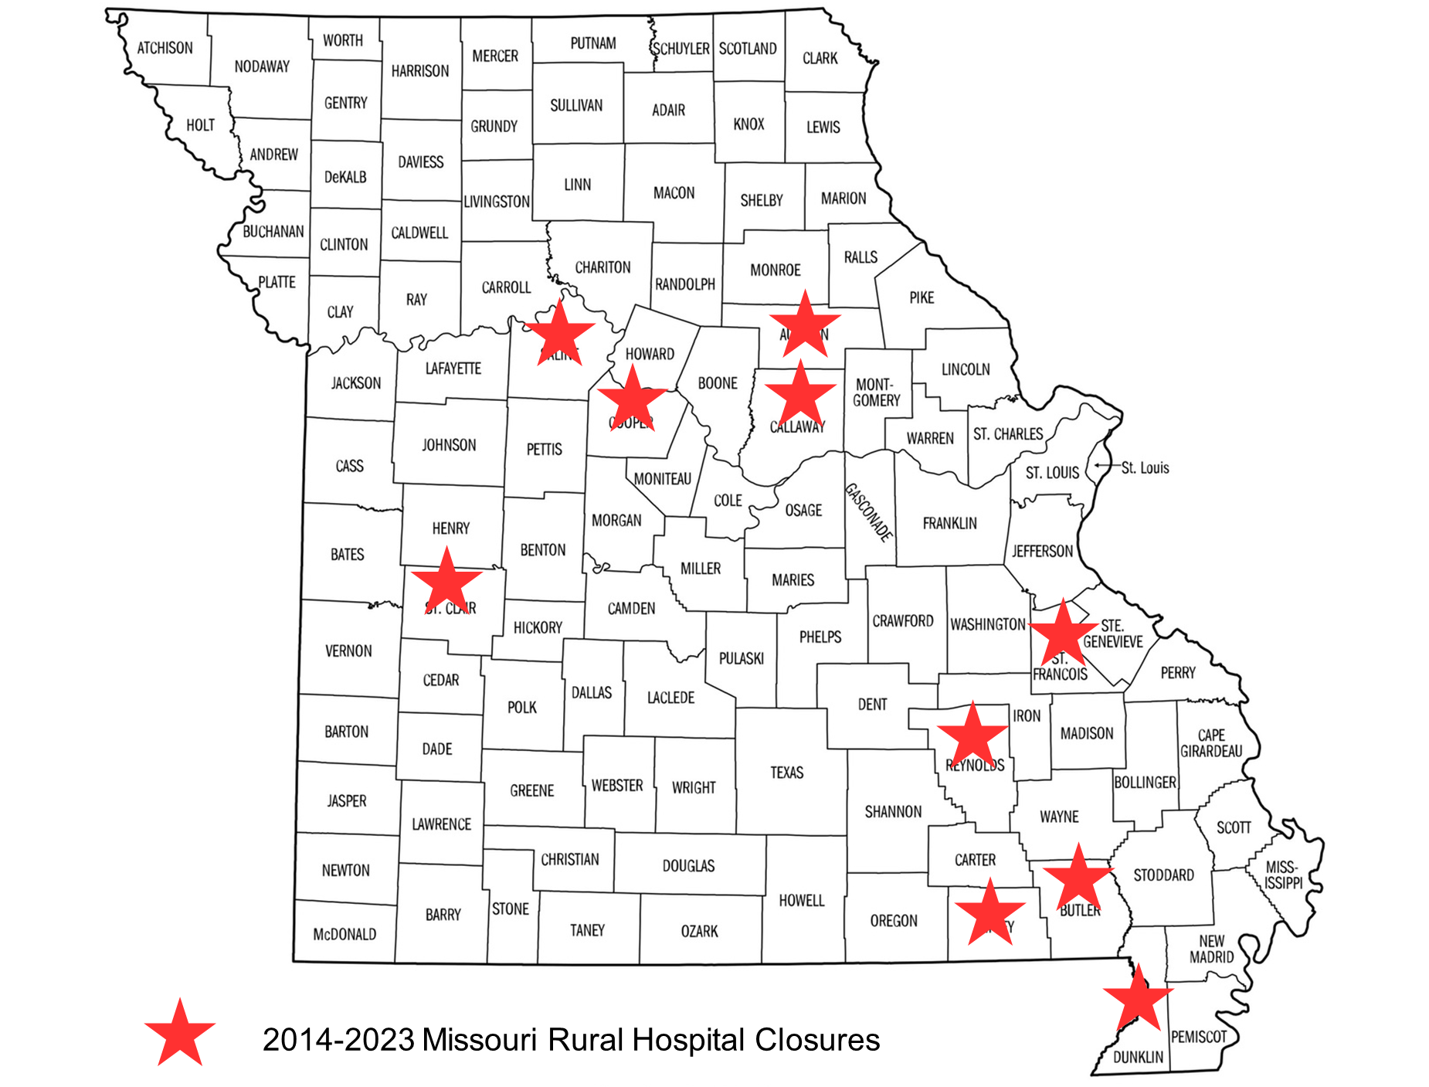
Needs Assessment Findings: Infrastructure
Rural hospitals face high costs & low reimbursement rates
  10 hospitals have closed in rural Missouri from 2014-2023
Hospital closures impact other infrastructure
  Roads and transportation
  Employment rates
  Secondary health providers

Slide 10
Needs Assessment Findings: Significant Needs in Rural Health
Stabilization of a larger rural healthcare workforce
The development of cross-discipline coalitions and partnerships
Reduced staff isolation and burn out
More accessible funding including coding and grant assistance
Enhanced outreach activities
Support of existing programs

Slide 11
Rural Communities are resilient
Resilience is amazing
Resilience has limits
We cannot expect our rural communities to heal and recover on resiliency alone

Slide 12
What do we do next?
The 2023 Needs Assessment spurred the creation of an online platform that featured collaboration and networking for rural health professionals
This resulted in lessened isolation, and stronger collaboration across Missouri and our neighboring states
The 2026 Needs Assessment led us to the Virtual Communities of Practice Model (VCoPs)
  This model was evidence-based and had promising results in shared learning, applied problem-solving, and coordinated action
  VCoPs improve clinical decision making, reduce professional isolation, and strengthen interdisciplinary collaboration across healthcare, education, non-profit, and international development settings

Slide 13
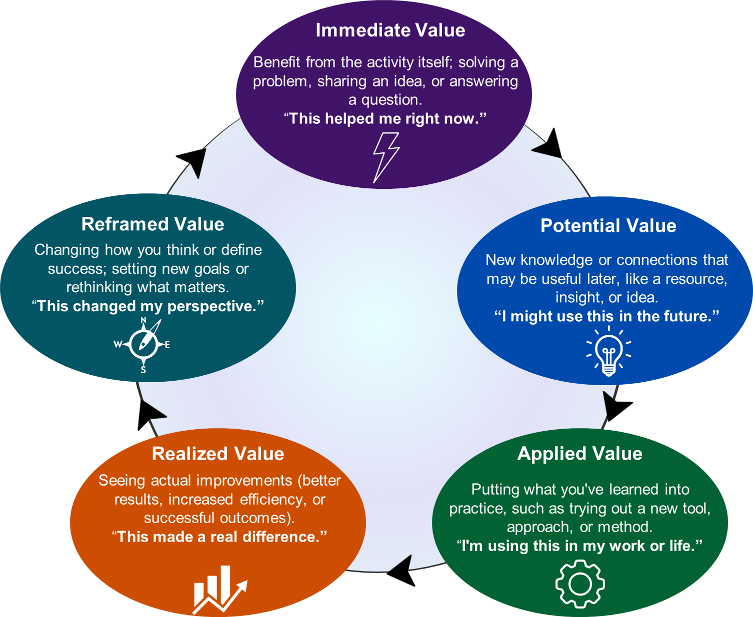
Virtual Communities of Practice (VCoPs)
VCoPs are focused on building different types of value for different users
Participation means learning and shaping professional identities
VCoPs have community-rooted solutions
This framework is best utilized when there is:
  A shared area of identity (Rural health)
  Community (Relationships and trust)
  Practice (Shared tools, language, and experiences)

Slide 14


Slide 15
The Causeway Features
Different online communities for users to utilize
Discussion boards and asynchronous discussion features to allow for collaboration across time commitments
Blogs and Resource listings
Private messaging
Libraries of content
Onboarding lessons
Much more!

Slide 16
Needs Assessment Findings: Significant Needs in Rural Health
Stabilization of a larger rural healthcare workforce
The development of cross-discipline coalitions and partnerships
Reduced staff isolation and burn out
More accessible funding including coding and grant assistance
Enhanced outreach activities
Support of existing programs

Slide 17
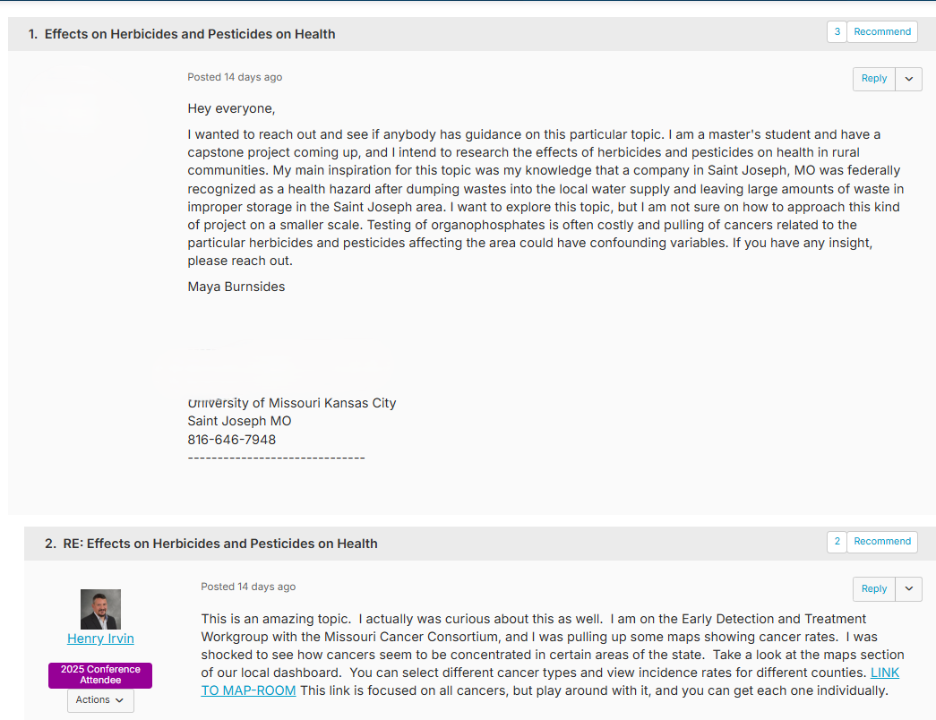
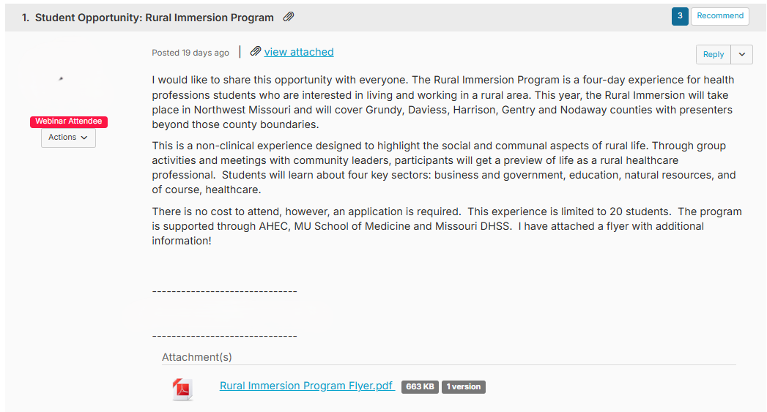
Stabilization of a larger rural healthcare workforce
Lack of incoming workforce continues to be a concern
Prominent levels of retiring workforce with low levels of new professionals focused on rural health

Slide 18
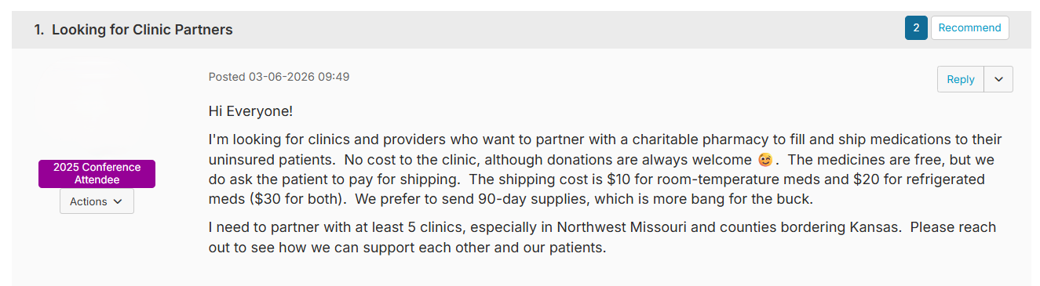
The development of cross-discipline coalitions and partnerships
Rural health issues continue to arise, and complex issues require teamwork and cross-disciplinary approaches

Slide 19
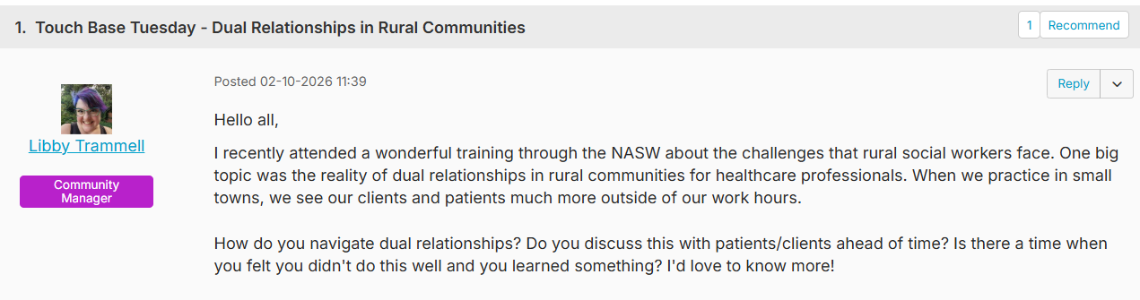
Reduced staff isolation and burnout
The Causeway has recently reached over 1,000 active users
We house professionals including:
  Doctors
  Nurses
  Social Workers
  Administrators
  Healthcare students
  Any rural healthcare professional or advocate is welcome

Slide 20
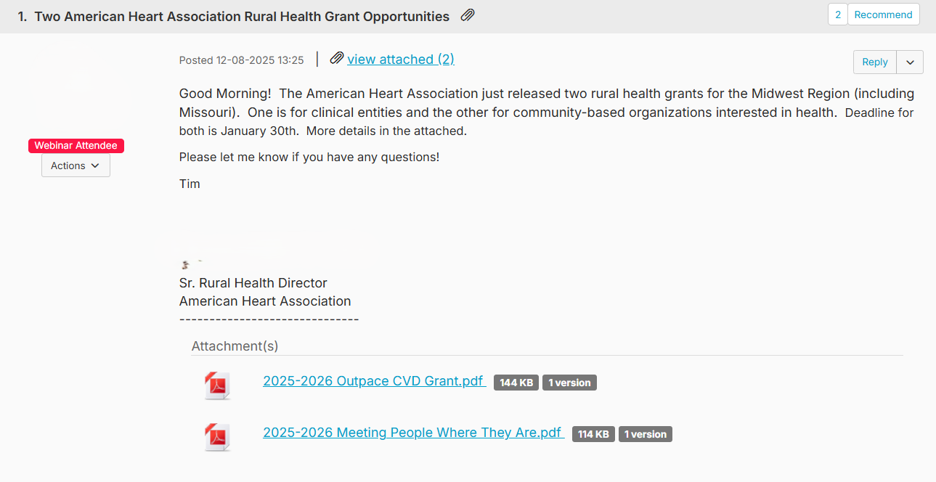
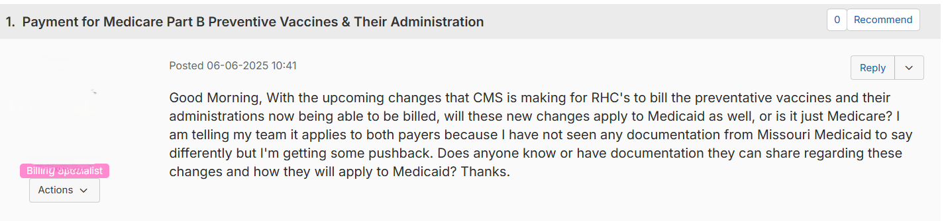
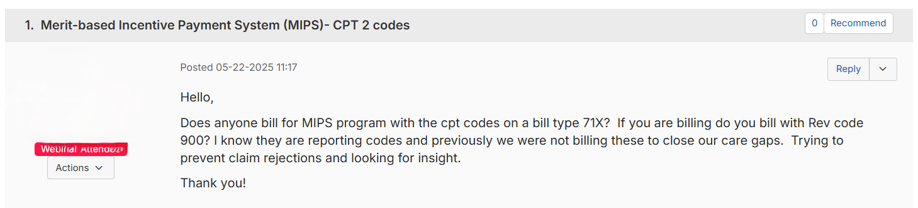
More accessible funding including coding and grant assistance
Coding can be confusing and cause practitioners to lose money
The grant and funding lanscapes continue to change quickly, and the need for funds continues

Slide 21
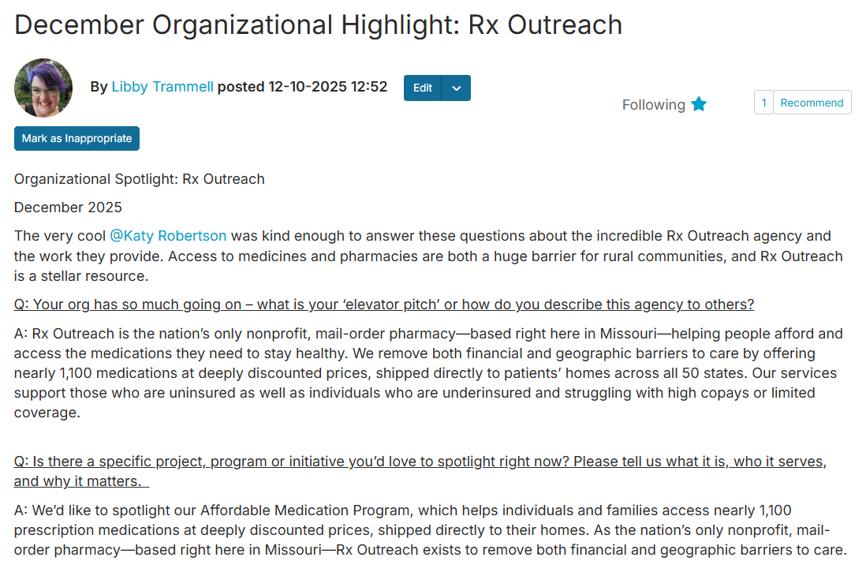
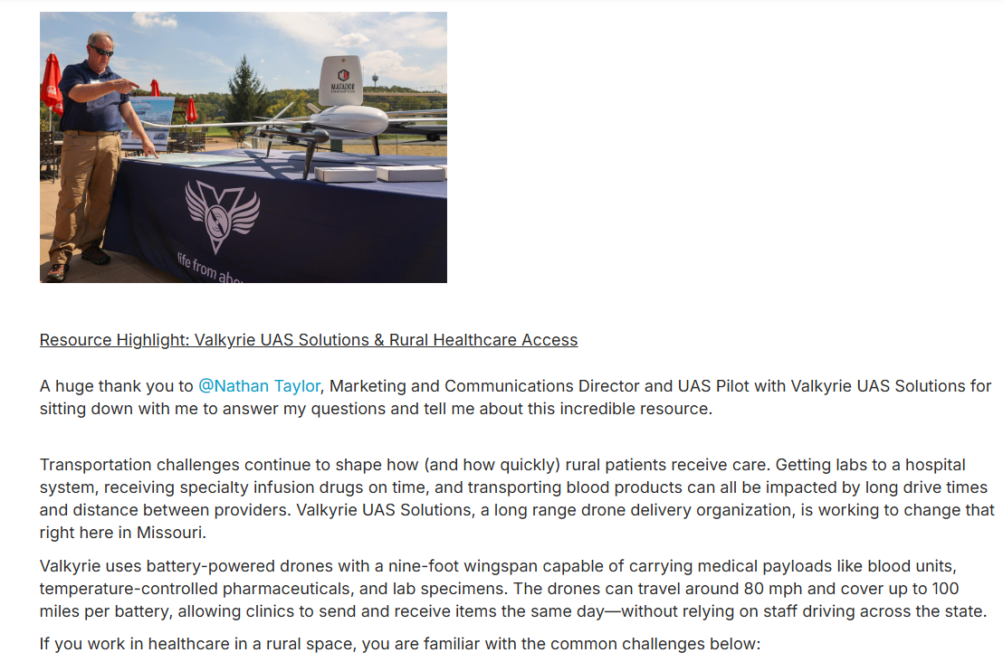
Enhanced Outreach Activities
There are fantastic services happening in rural Missouri, but outreach and accessibility remain an issue

Slide 22
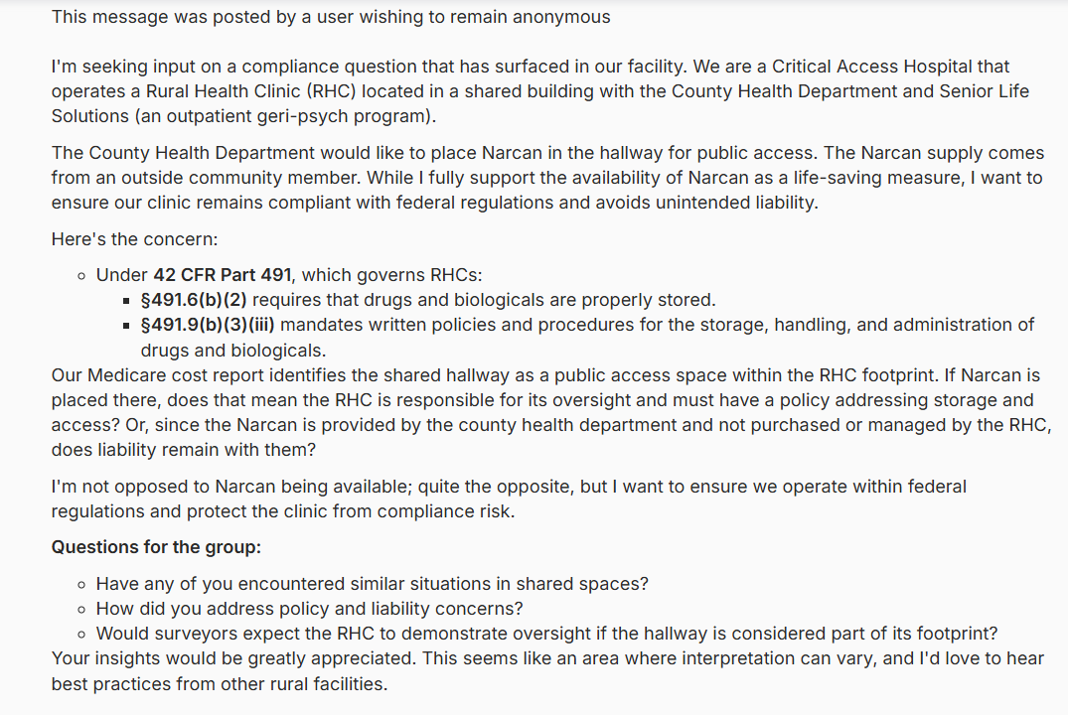
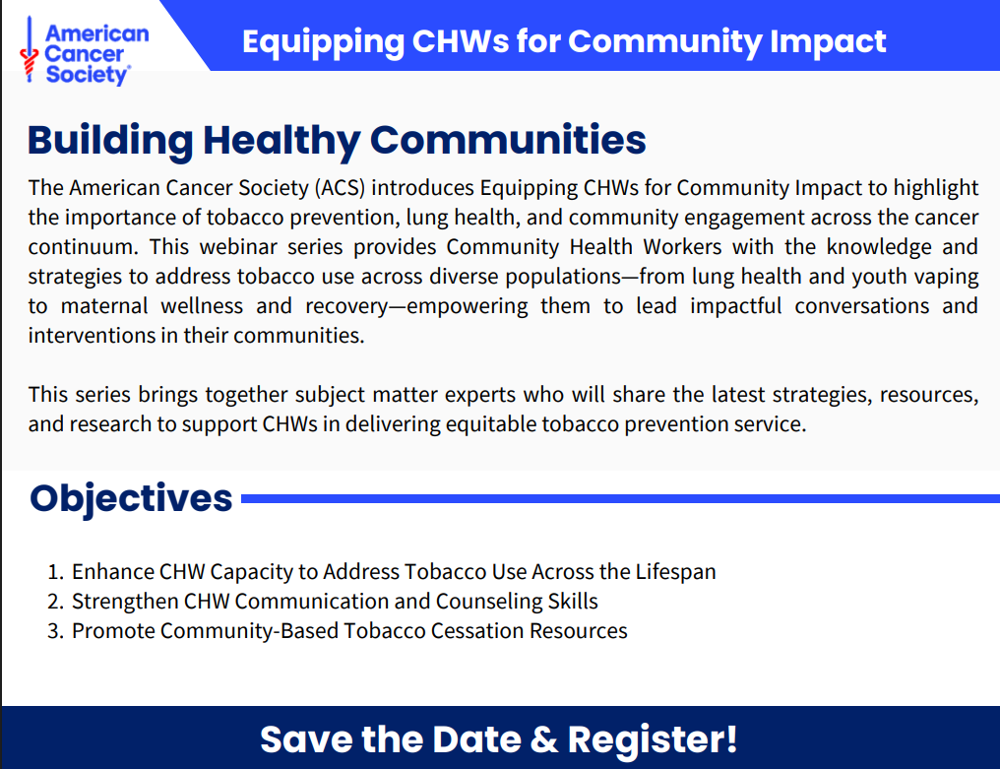
Support of Existing Programs
Existing programs require support and awareness
Infrastructure to boost involvement is lacking

Slide 23
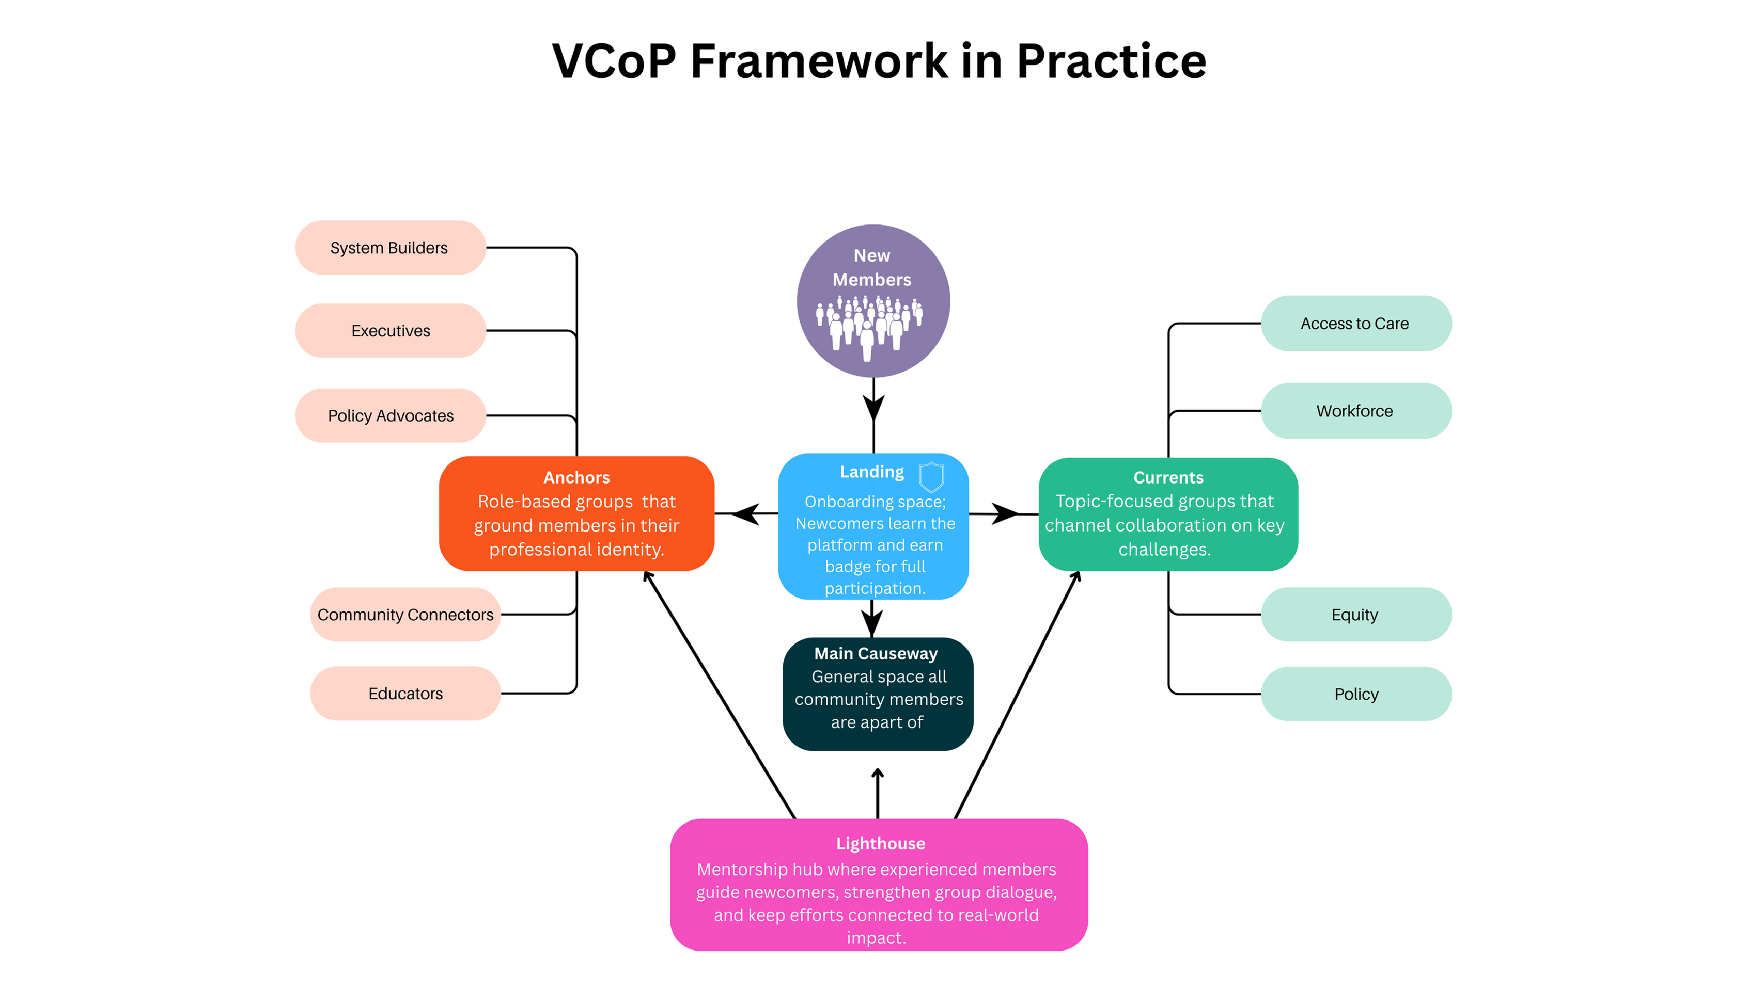

Slide 24
Projected Cost - $250K Annually
Platform Licensing
Personnel onboarding and salary
Learning Management System
Administrative Overhead
Proposed expansions
Advertising and Outreach

Slide 25
What funding can mean
Further Anchor and Current Communities
  Maternal health, Dental health, etc.
Private communities for agencies
  Reach out to Libby for more information
Specific staffing for building out further programming
Dedicated spaces for specific interventions
Much more

Slide 26

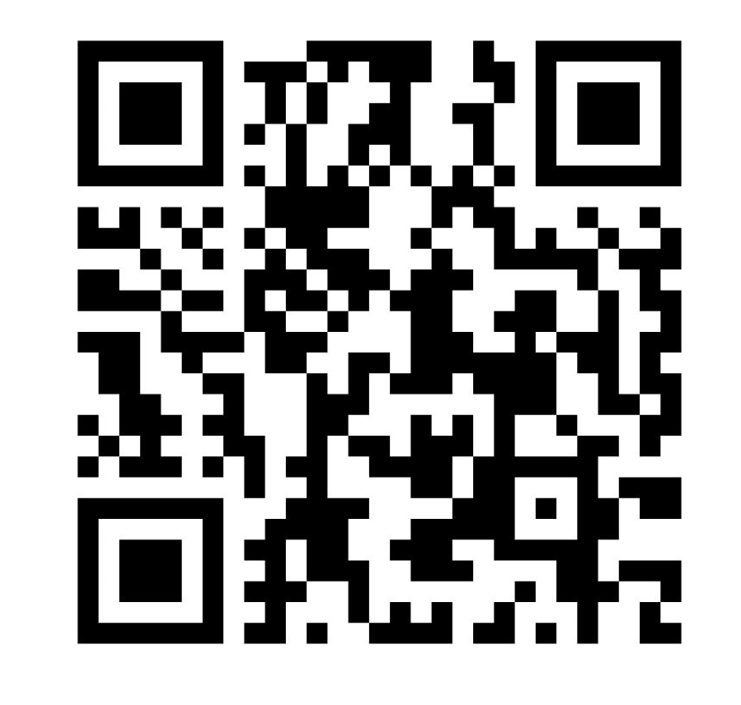
Learning More
Read the 2026 Needs Assessment
Join us on The Causeway

Slide 27
Questions?
Ltrammell@morha.org

