Slide 1
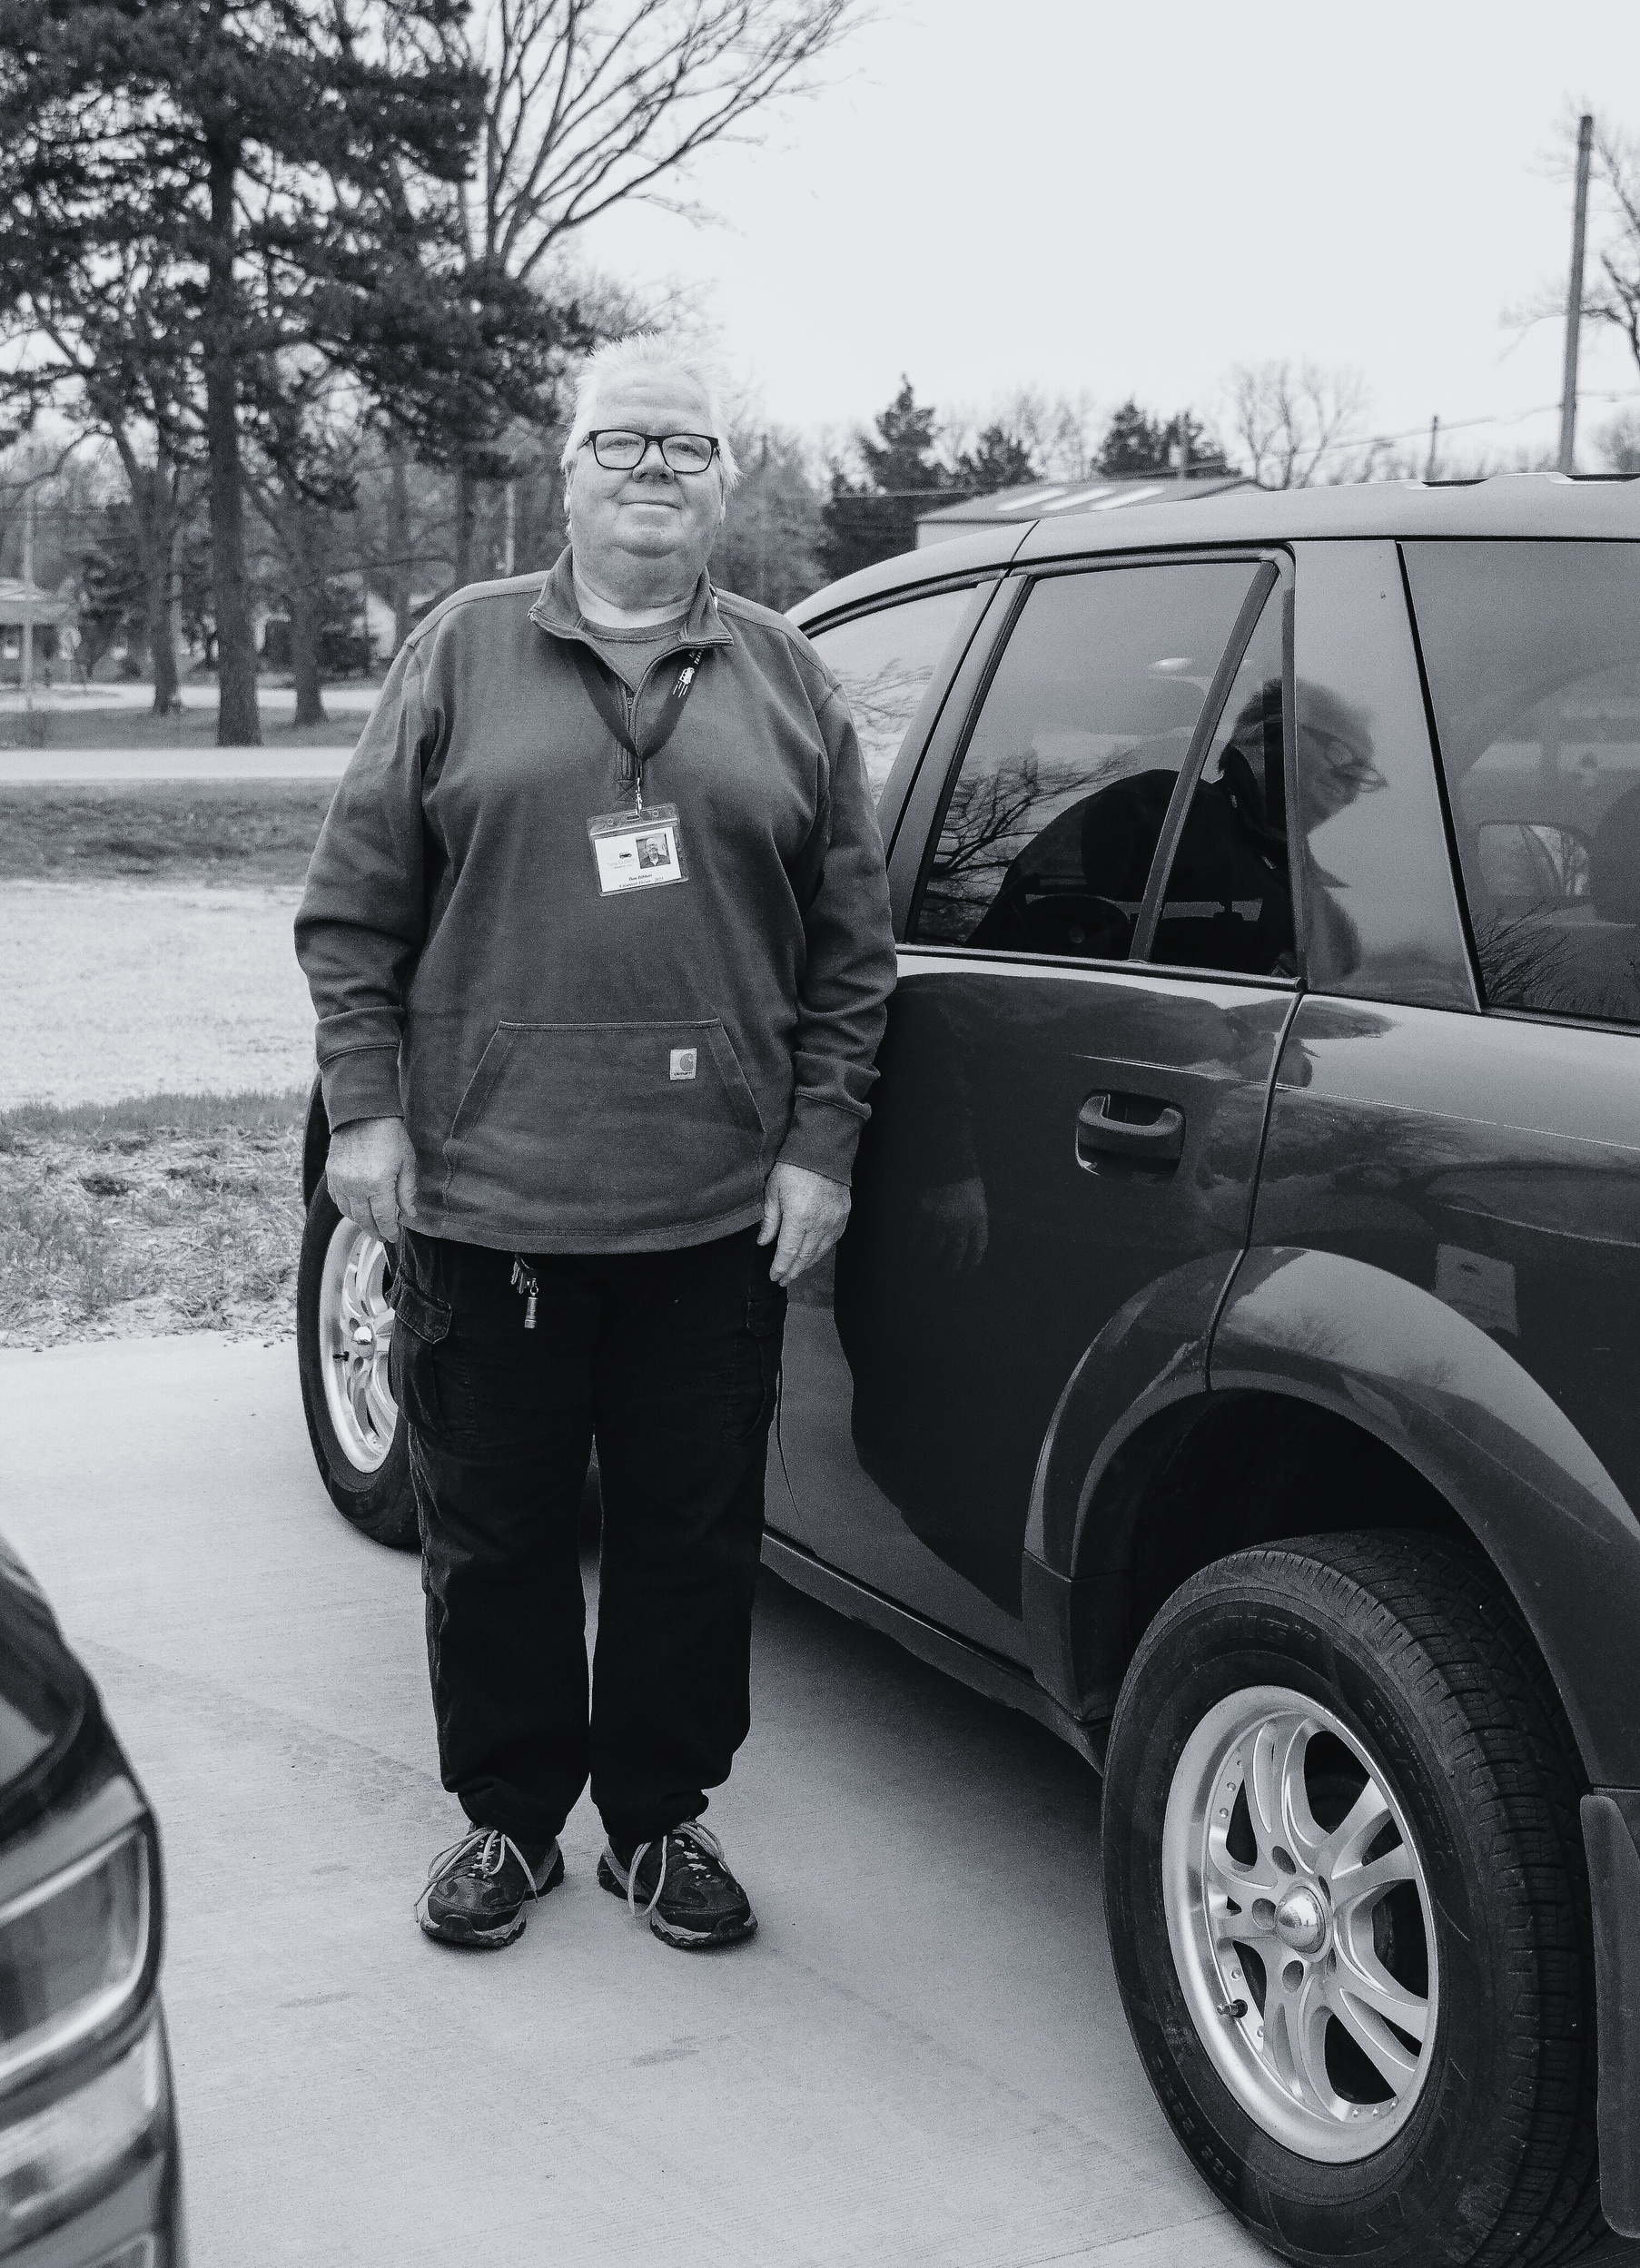


Volunteer Driver Network

Slide 2
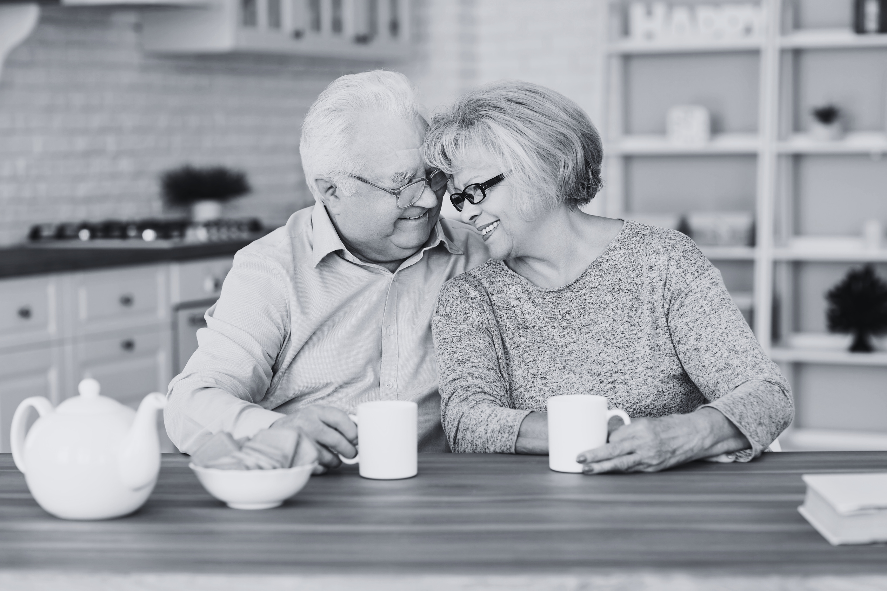
WORK HERE
LIVE HERE
STAY HERE
It’s where we call Home

Slide 3
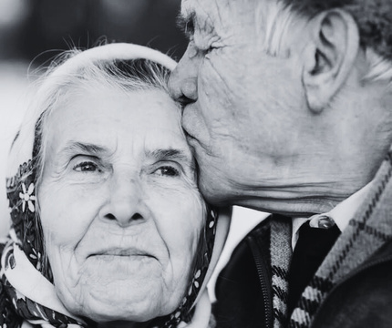
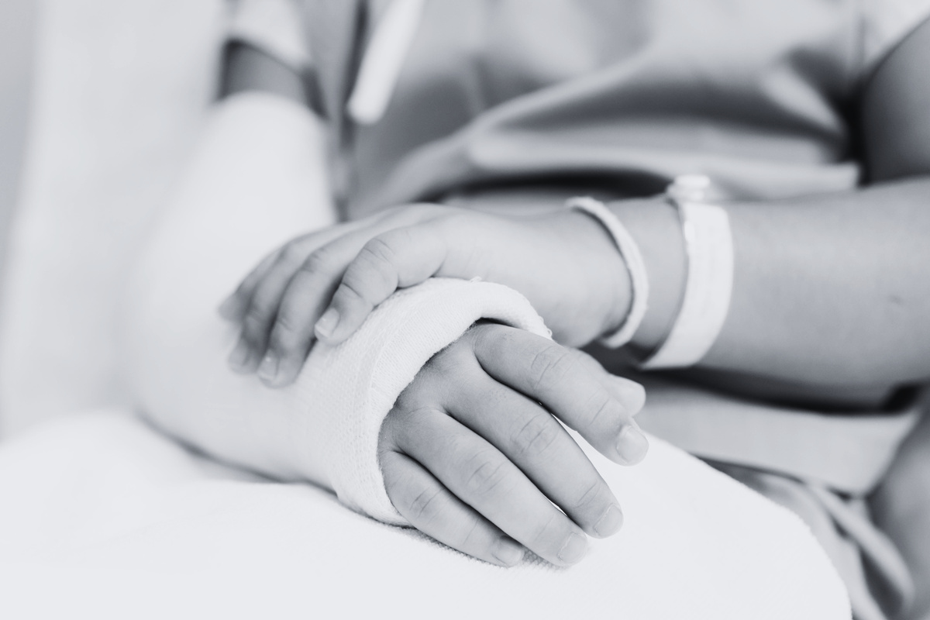
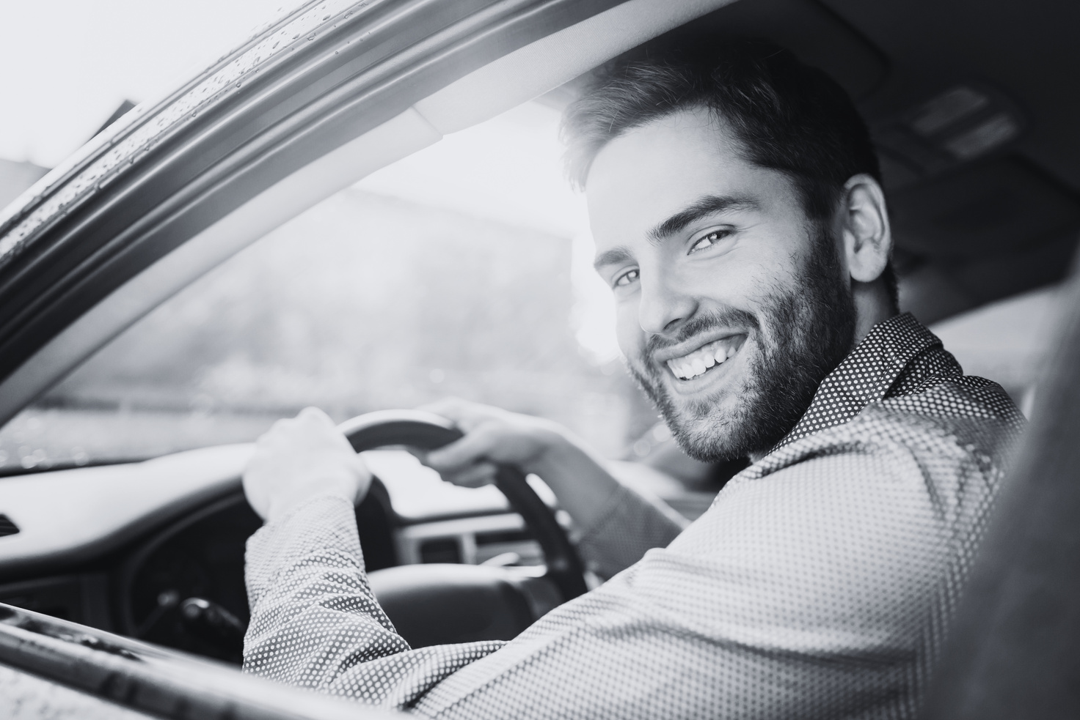
Seniors
“Hung up keys for good”
Avoid “city” driving
High frequency needs
WHO NEEDS TRANSPORATION
Not Able to Drive
Injured or recovering
Blind or low vision
Developmental disabilities
Limited Access
No license
No car
Limited Public Transportation

Slide 4
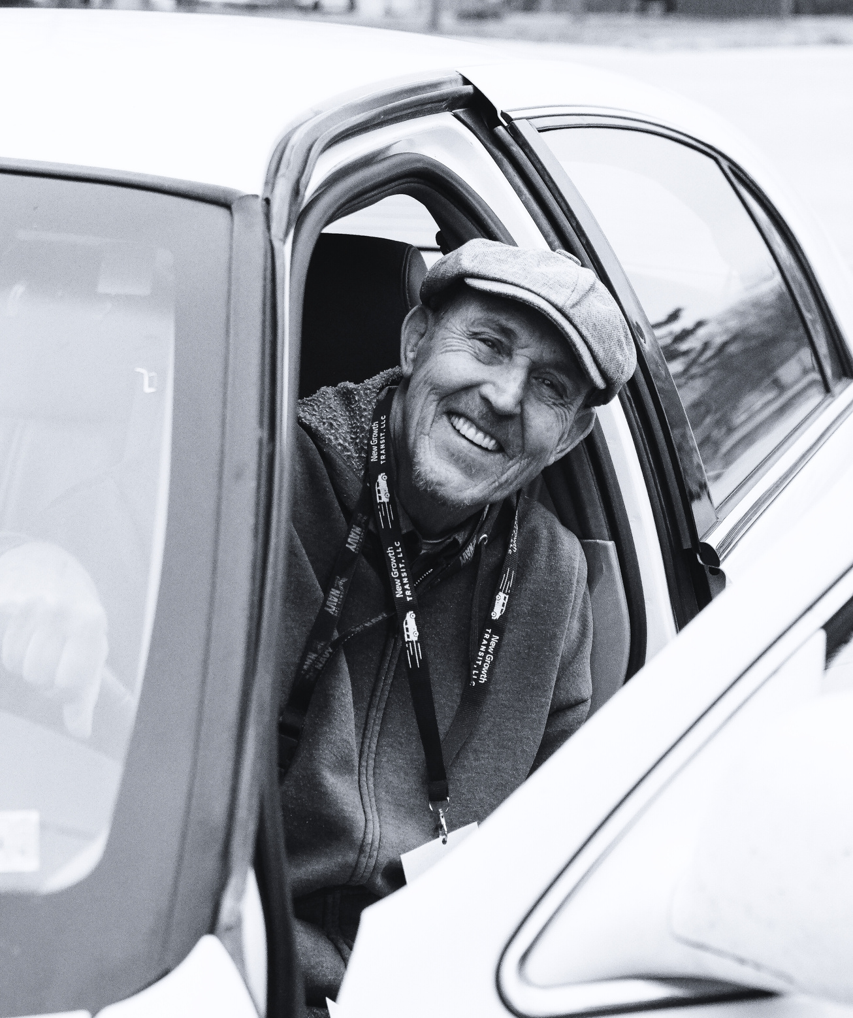
They choose their availability & where willing to drive.
Because they drive their own car, no special license needed, and volunteer insurance is provided.
WHAT’S A VOLUNTEER
DRIVER
Reimbursed $0.67 - $0.70 per mile - it’s a reimbursement, NOT income - doesn’t affect benefits they may already be receiving.
Many have said they started for monetary reasons, but now love “having a reason to get out” and being able to help people.

Slide 5
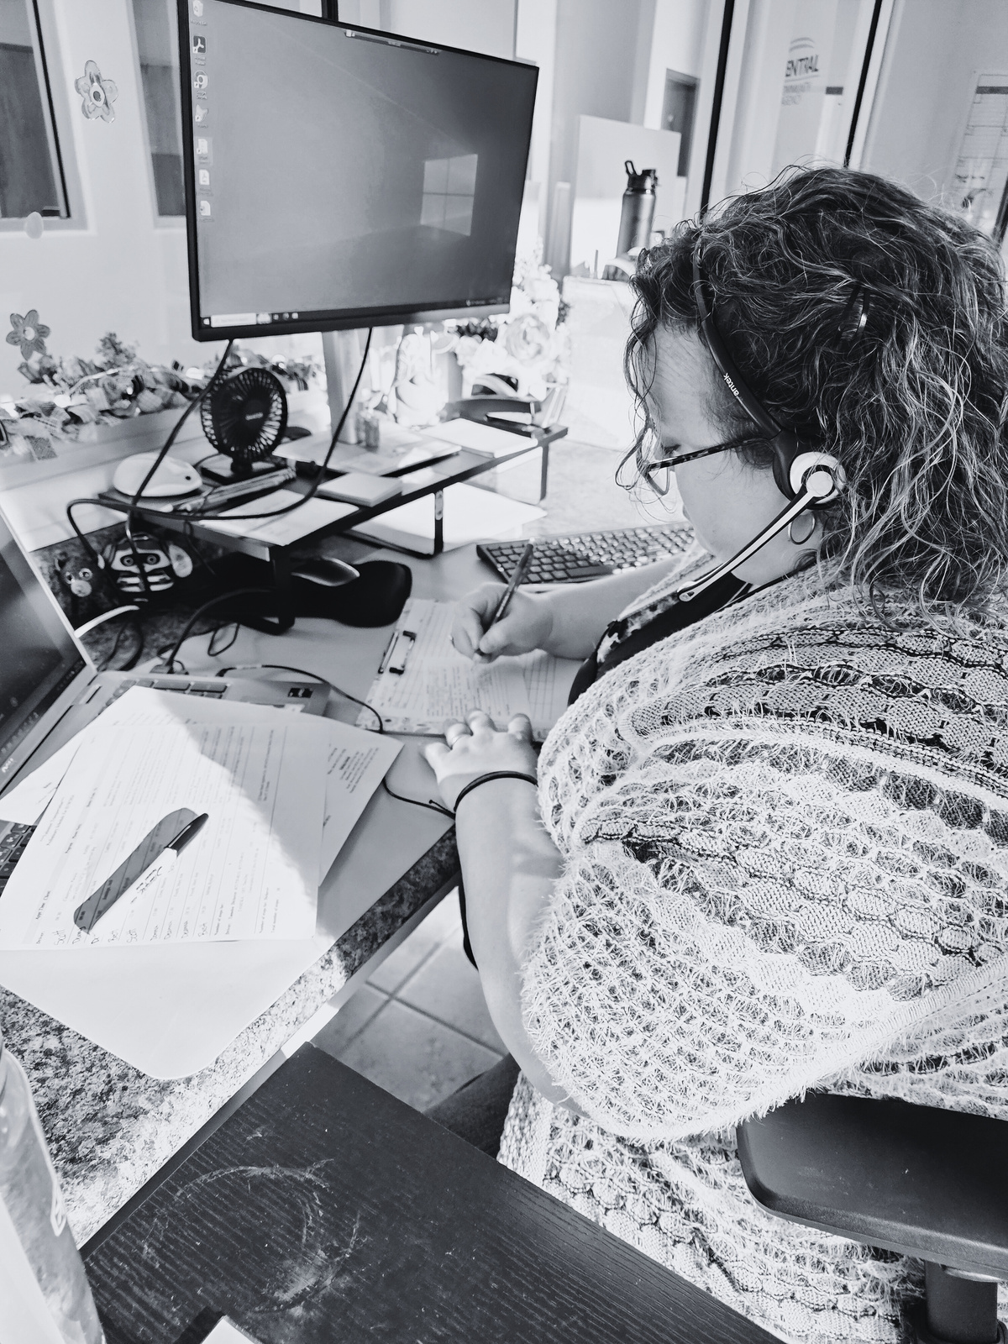
HOW DOES IT WORK
Drivers are trained on technology and the program
Technology is used to schedule, track, and log miles
Riders call in to request a ride at least 48 hours in advance
Drivers pick up, wait and return riders
Rides are scheduled, coordinated, and communicated with drivers
Drivers’ reimbursements sent 2x a month

Slide 6
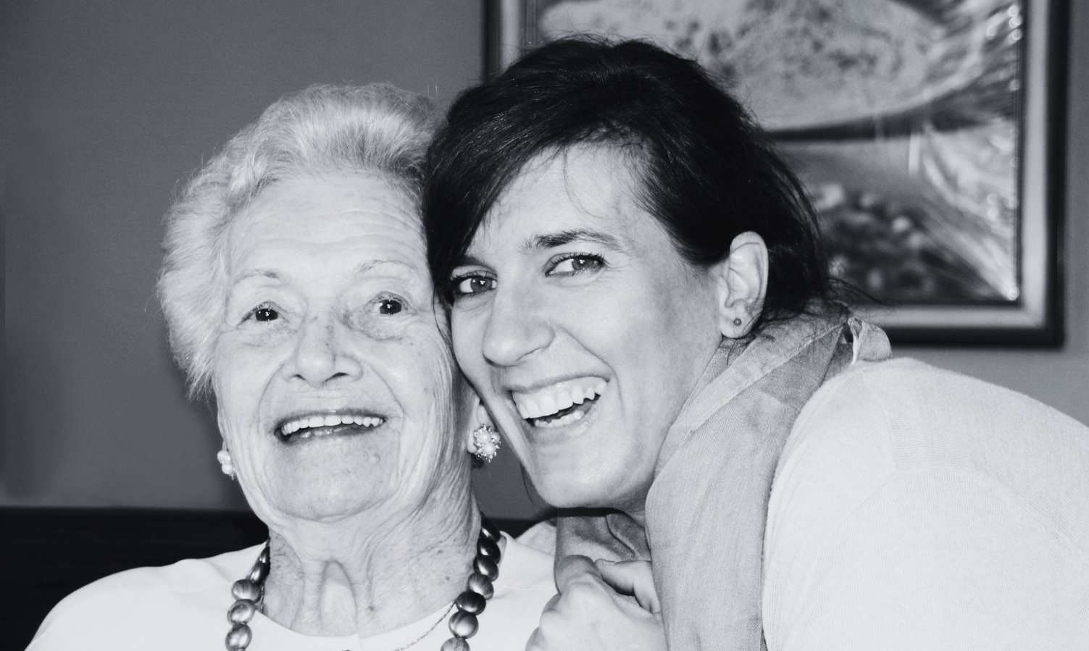
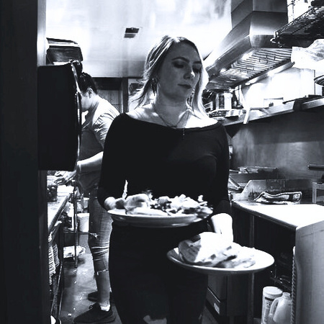
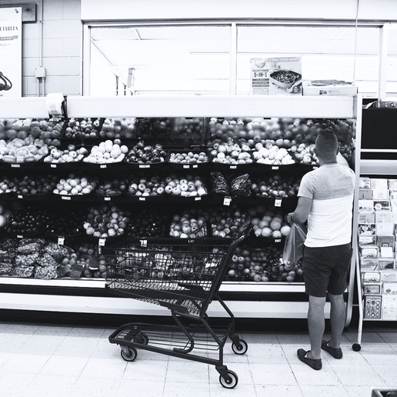

TRANSPORTATION
WORKFORCE
SHOPPING & MORE
JUSTICE SYSTEM
HEALTH CARE
Employment
Education
Childcare
Groceries and Food Banks
Pharmacy
Social Services & Community
Banking & State Offices
Court Appointments
Legal Services
Recovery Court
Child Custody Visits
Medical
Dialysis
Mental Health
Vision
Dental

Slide 7
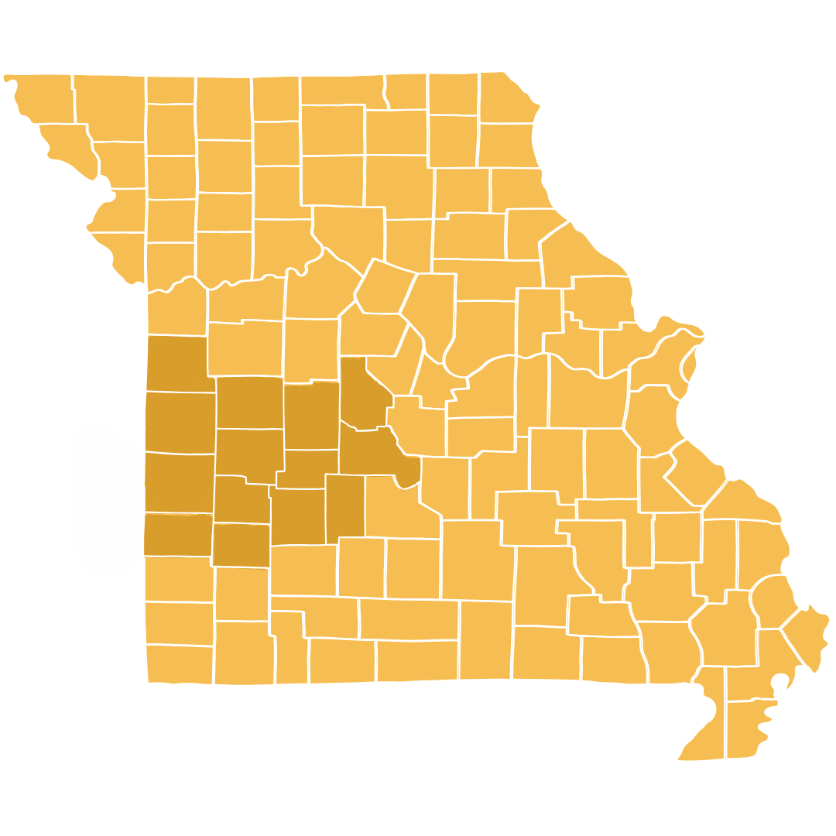
WHERE DO WE SERVE
New Growth Transit - Missouri Counties
  Bates
  Benton
  Cass
  Cedar
  Dallas
  Henry
  Hickory
  Morgan
  Polk
  St Clair
  Vernon

Slide 8

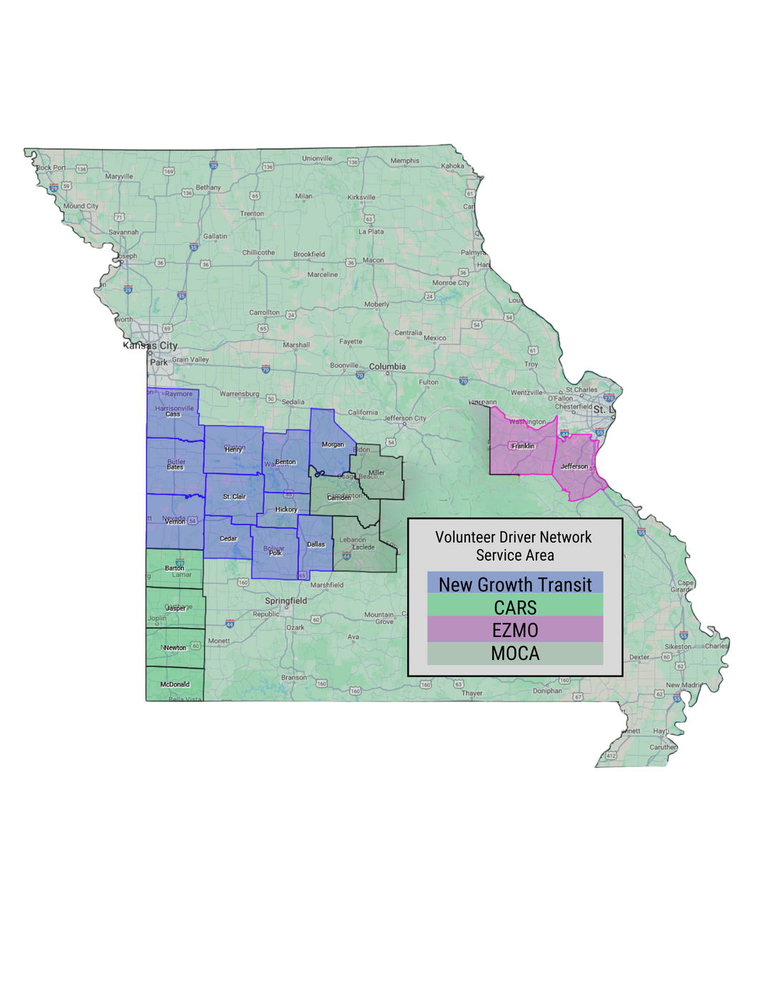


MISSOURI VOLUNTEER DRIVER NETWORK
Started Fall 2020
13 Counties
71 Volunteer Drivers
Started August 2024
8 Counties
18 Volunteer Drivers
Started May 2024
4 Counties
34 Volunteer Drivers
Started May 2023
2 Counties
47 Volunteer Drivers

Slide 9
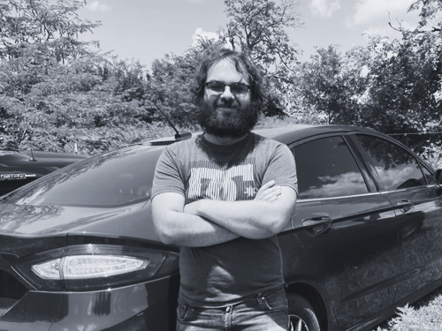
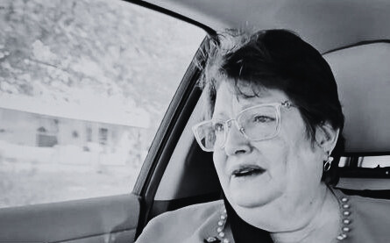
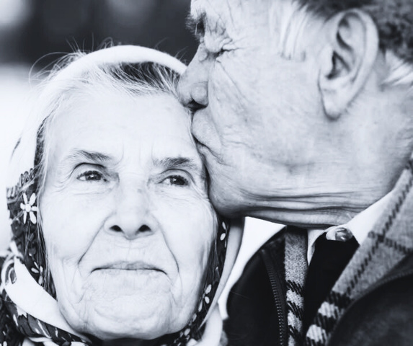
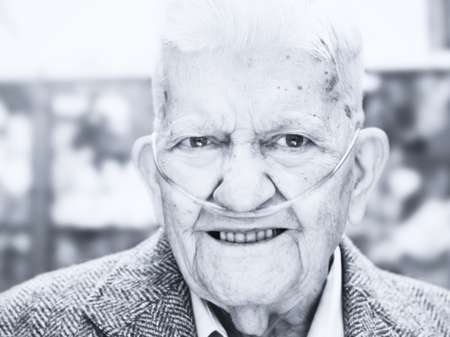
RIDERS TESTIMONIES
Dustin, a 24-year-old with autism from Polk County is thriving at his job at Walmart, thanks to the reliable support of New Growth Transit relieving his family from taking time away from their jobs to get him to every shift.
Pamela, a widow from Cedar County, shared that during her husband’s final days, the rides to his doctor appointments were some of the only times he smiled or laughed. Despite his pain, he found comfort and connection with his volunteer driver.
James and JoAnn of Benton County, a couple in their 90s, are deeply grateful for the rides that help them stay independent and get to twice weekly medical appointments—taking a big burden off their children, who would otherwise miss work to help.
Frank, a veteran living alone in Henry County who so depends on oxygen he is at risk of passing out during long power outages, is incredibly grateful for the rides that help him get to the store and his doctor appointments.
Read these & more: newgrowthmo.org/category/transportation

Slide 10
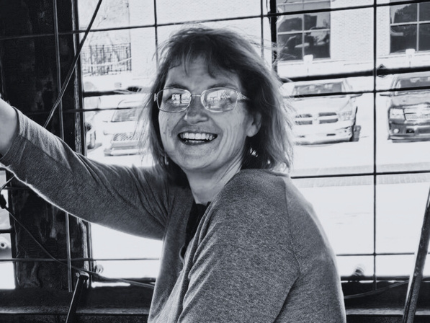
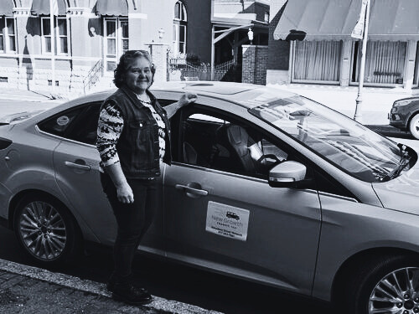
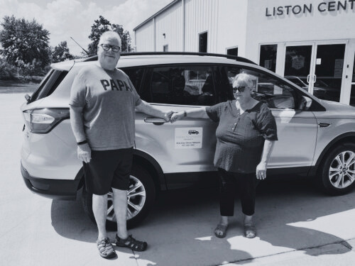
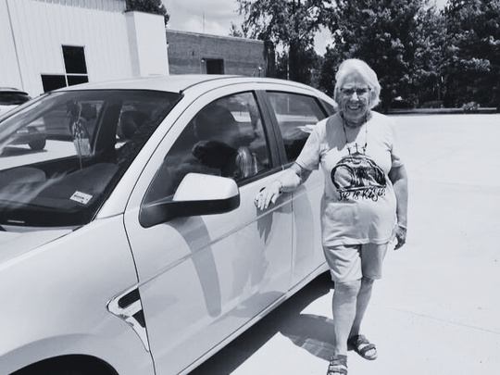
DRIVER TESTIMONIES
Tameka, a driver from Dallas County said, “I'd been on disability for years when I was diagnosed with cancer. After the good Lord healed me, I felt motivated to find something meaningful I could do other than sitting around. It lifts my spirits too.”
Kate from Benton County drives as often as she can. “I’ve always loved to drive, but even more than that, I love people. Every ride is a chance to brighten someone’s day.”
Don & Lori, both drivers from Cedar County say, “It’s a wonderful way to spend your time,” Lori says, “and the difference you can make in someone’s life is incredible.”
Jeremi, a retired woman on social security from Cedar County calls it “work without working!” It not only helps her, but it really helps the riders because everything is so far away.

Slide 11




Refer
WHAT IS NEEDED
Tell others about volunteer driving.
LOCAL OWNERSHIP
Support your community with transportation!
Advocate
Change systems in Missouri
Donate
Fund community programs that include all ages, because everyone deserves access.

Slide 12
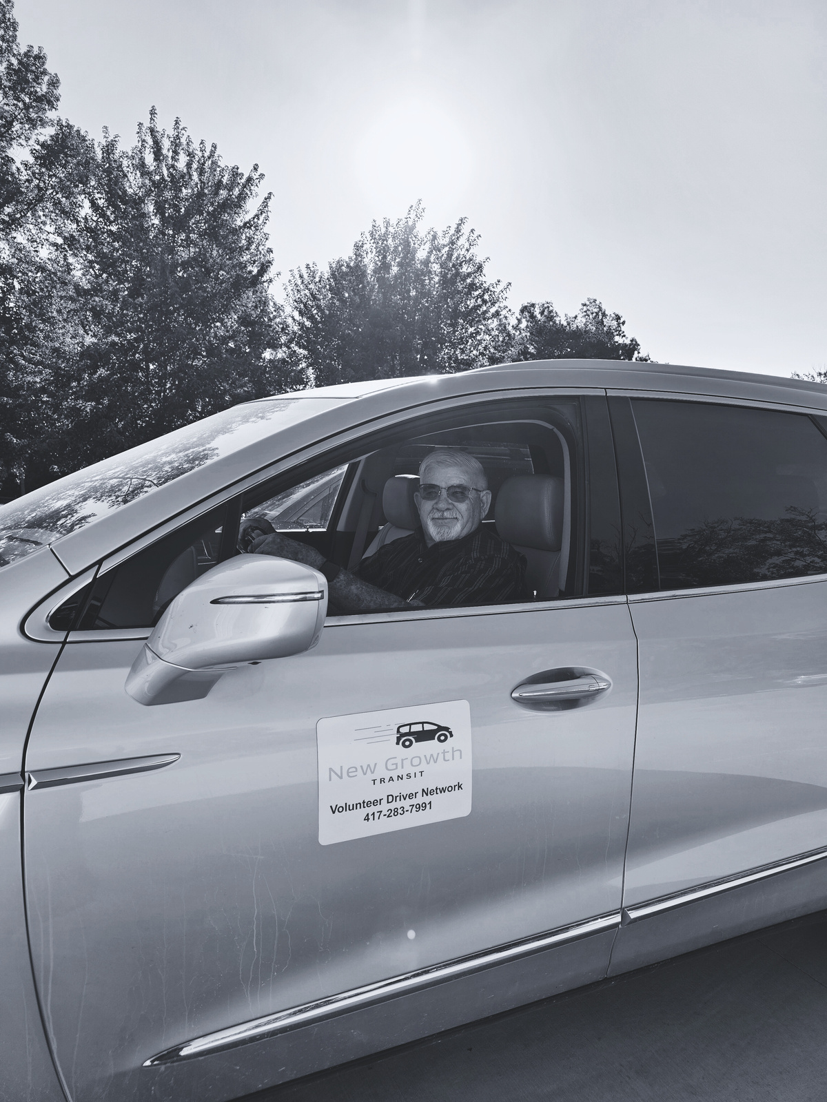
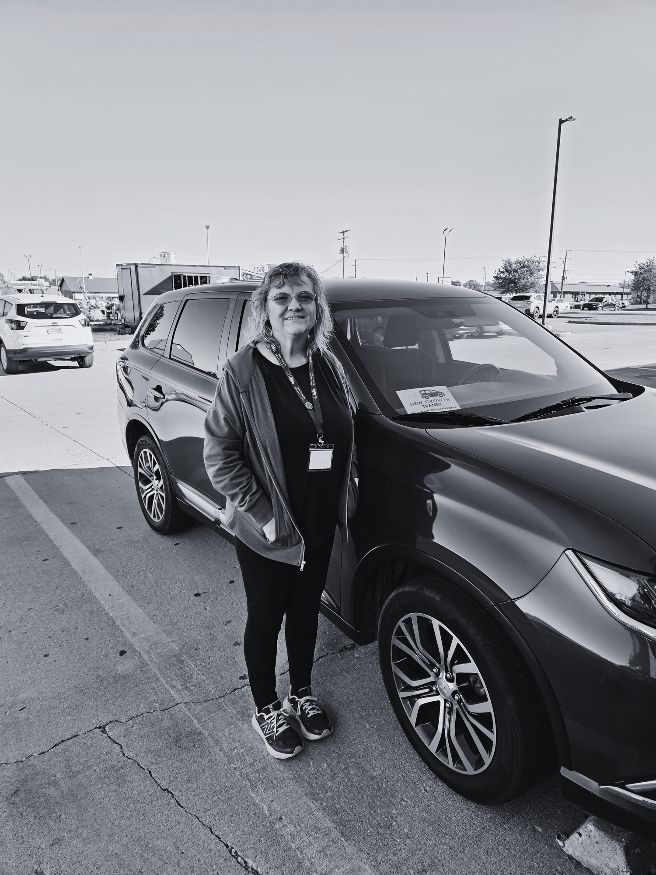
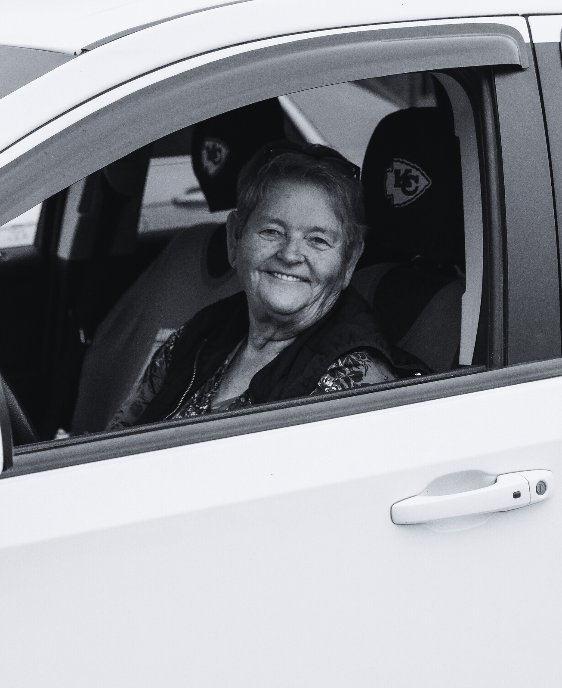
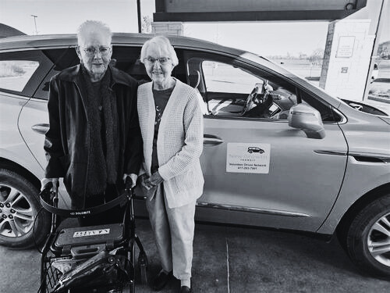
CONTACT US
Kelly Ast
Kast@wcmcaa.org
417-283-7991 ext. 3162

