Slide 1


The New Era of Philanthropic Capital
How Venture Philanthropy Creates Evergreen Impact Through Co-Investment
Presented by

Slide 2

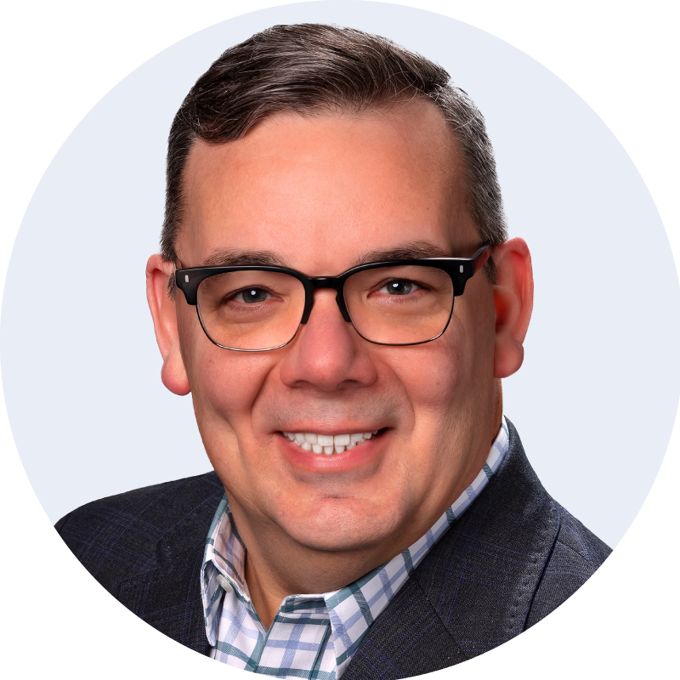
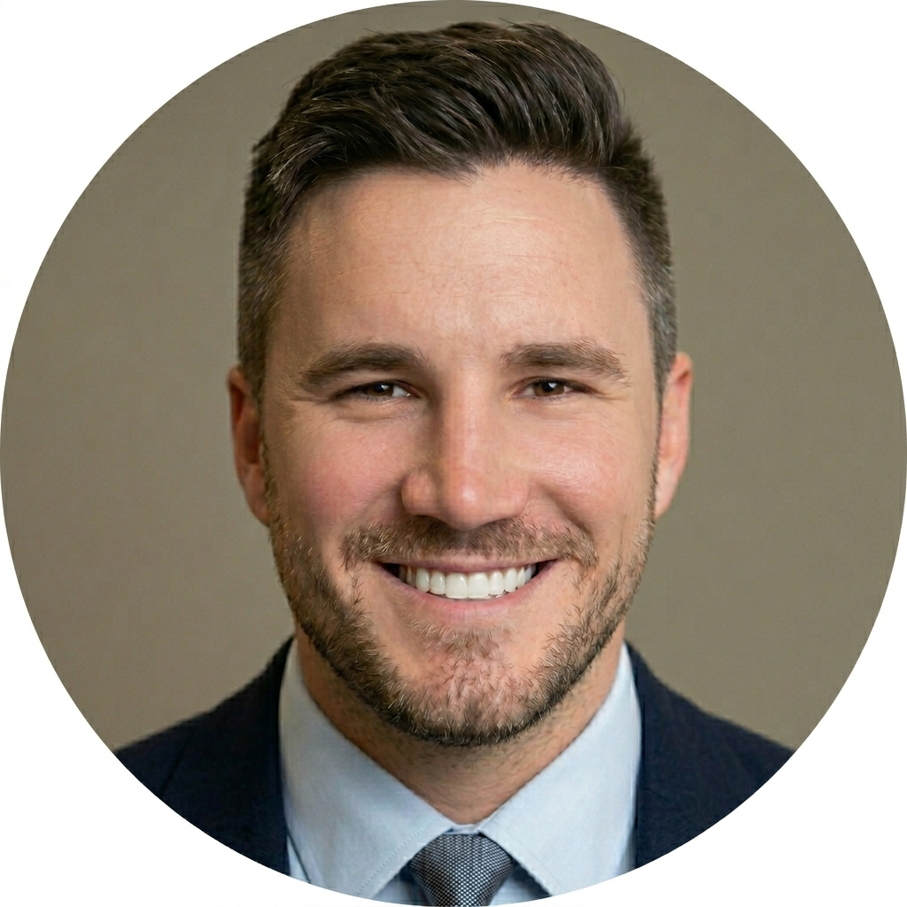
Meet Your Panel
Dr. James Stapleton
Charles Elliott
Codefi Foundation
Springfield, MO
Co-founder,
Innovate SOMO Funds
Codefi Foundation
Springfield, MO
VP of Strategic Growth
3

Slide 3

Welcome and Expectations
45-minute educational session followed by 15 minutes for Q&A.
What’s NOT Covered Today
Today is About:
❌ Specific fund terms or
investment opportunities
❌ Solicitation of commitments to
any fund
❌ Financial projections or return
expectations
❌ Individual investment advice
Understanding the model
Learning from experienced practitioners
Exploring regional transformation potential
2

Slide 4
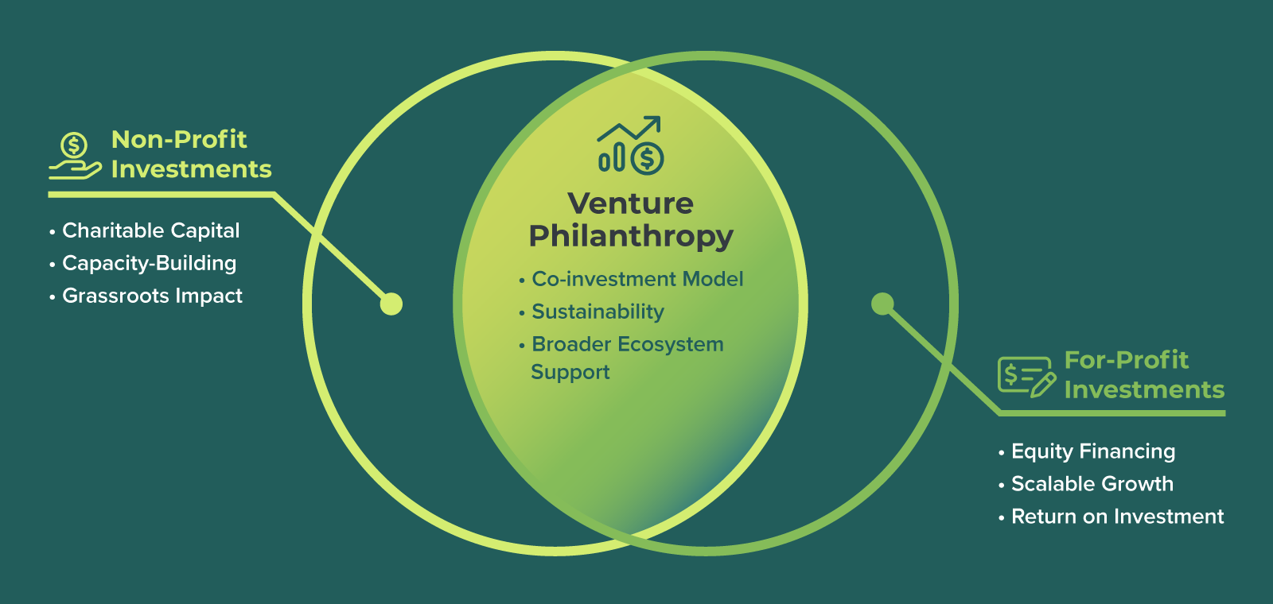
What is a Venture Philanthropy Fund?
2

Slide 5
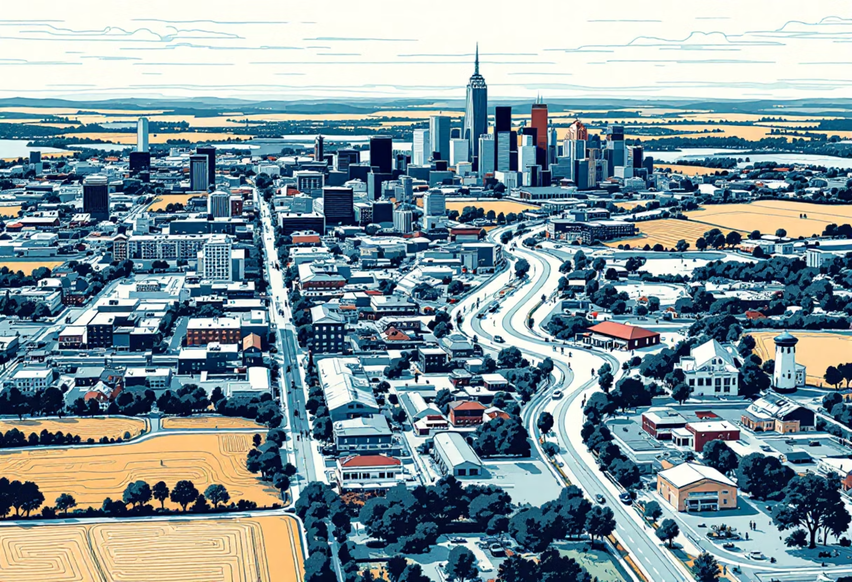
Case Study: Launch NY
Upstate New York’s Success Story
The Model
501(c)(3) nonprofit + for-profit LP fund
U.S. Treasury-designated CDFI
27 westernmost counties
(rural/mid-sized metros)
The Results
#1
1,800+
9,600+
39x
Most Active Seed
Fund in NY State
Companies
Mentored
Jobs Supported
Follow-on Funding For Portfolio Companies
Key Success Factors
✓ CDFI designation unlocked federal capital
✓ Mentorship-first approach improved quality
✓ Geographic focus = competitive advantage
✓ Rapid deployment (90 deals in 3 years)
4

Slide 6

Case Study: KCRise Fund
Community-Anchored Capital
The Model
Community foundation-anchored fund
Multiple philanthropic anchors + individual donors
Focus on local high-growth software entrepreneurs
Co-investment with traditional VCs
Key Learnings
Anchor Commitments
Patient Capital
✓ Anchor commitments attract
follow-on donors
✓ Patient capital timeline (7-10 years)
essential
Community Trust
Sector Focus
✓ Community trust built through transparency
✓ Sector focus helps deal flow quality
5

Slide 7
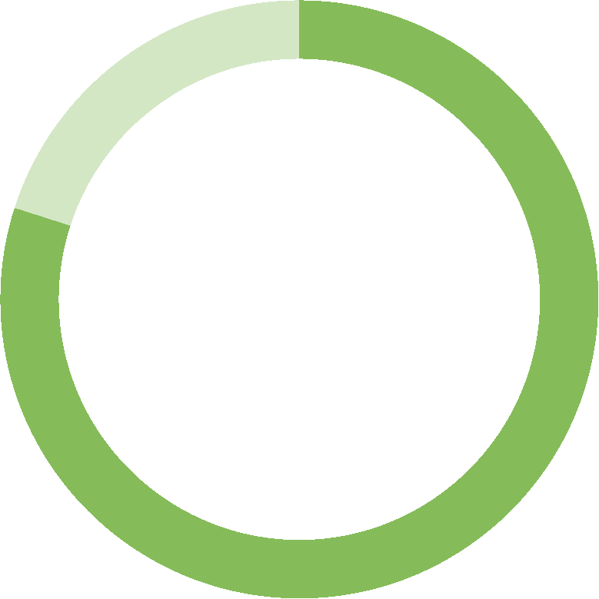
The Philanthropic Dilemma
Traditional Philanthropy: Deploy and Done
The Current Model
1.
Grant
Made
2.
Program Delivered
3.
Impact Achieved
4.
Capital Gone
The Challenge
Venture Capital Concentration
80%
💰 80% of U.S. venture capital flows to California and New York
6

Slide 8
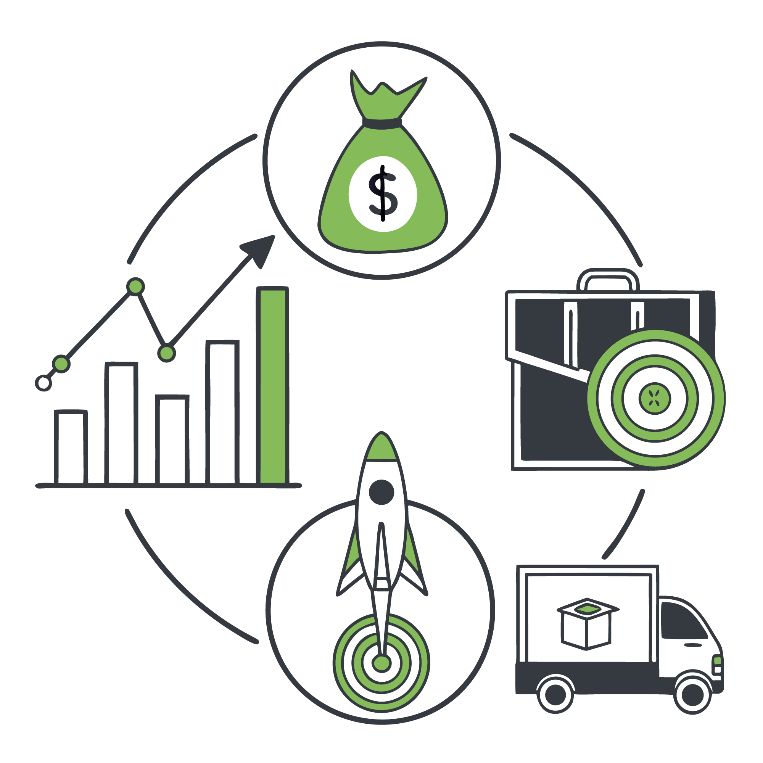




The Evergreen Model
From Spending Down to Building Up
Traditional Grant
Venture Philanthropy
$1M Spent → $1M Impact → DONE
$1M Invested → Returns Generated →
Capital Recycled → Compounding Impact
The Math of Compounding
Years 1-3
Years 4-7
$1M → 10-15 companies funded
Exits generate returns
Years 8-10
Years 10+
Reinvest $1.5M+ in new ventures
Original $1M created $4M+ deployed capital
7

Slide 9

Co-Investment Structures
Amplifying Impact Through Leverage
Tiered Returns
Dual Entity
Philanthropy accepts lower returns; private capital gets upside
Nonprofit + for-profit fund working together
The Amplification Effect
Philanthropic Alone
With Co-Investment
8
$0
$1.5M
$3M
$4.5M

Slide 10





Why Missouri?
Regional Impact Potential
The Capital Desert
Pre-seed and seed-stage funding nearly non-existent
Traditional VCs won't travel for small checks
High-potential startups forced to relocate
Local jobs and wealth creation lost
Sector Opportunities
HealthTech +AI
AgTech +AI
Manufacturing +AI
Regional hospital systems + aging population
$8B agricultural economy + innovation needs
$48B GDP + advanced mfg growth
The Multiplier Effect
Every high-growth job created → 2-3 additional local jobs
9
Notes:
ED AND JAMES

Slide 11

Donor Advantages
Why Choose Venture Philanthropy?
For Major Donors
For Family Foundations
For Corporate Foundations
Multiplied impact across multiple funding cycles
Active engagement with portfolio companies
Measurable outcomes (jobs, revenue, exits)
Multi-generational legacy vehicle
Tax advantages (immediate charitable deduction)
Meets 5% distribution requirement (PRIs)
Preserves corpus through returns
Engages next generation in active giving
ESG and impact reporting
Early visibility into emerging technologies
Employee engagement opportunities
Community economic development
10

Slide 12
Local Example: Innovate SOMO Funds
From Theory to Practice in Southern Missouri
Launched: 2025 (formed in 2023)
Geography: 47 southernmost Missouri counties
Structure: Dual fund model (nonprofit + for-profit LP)
The Funds
Nonprofit Fund
For-Profit LP Fund
Co-investment with LP Fund, matching terms, evergreen
Market-rate returns, accredited investors, no admin fees or carried interest
Investment Focus
Stage: Pre-seed ($50K-$250K) and seed ($250K-$5M)
Sectors: HealthTech, AgTech, Manufacturing, FinTech with Software / AI Focus
Target: 15-25 portfolio companies in initial vintage
12

Slide 13





Codefi: Pipeline Integration
Beyond Just Capital
The Complete Development Ecosystem
AI Tech Training Programs
AI Skills for Entrepreneurs
Vibeathon Missouri events
Make Missouri AI-Ready
Startup Validation + Traction
Traction Studio AI - intelligence + tools + technical assistance
Ready To Raise - education and preparation for those seeking funding
Pitch events, investors introductions
Capital Deployment
Pre-seed: Innovate SOMO Funds
Seed: Co-investment with angels/VCs
Growth: SSBCI, institutional rounds
13

Slide 14
Early Validation
Building Momentum
Capital Commitments
Ecosystem Support
(Pre-Public Fundraising)
Community Foundation of the Ozarks partnership
$2M EDA Build to Scale federal grant
Missouri ARPA investments
Missouri Technology Corporation programs
$700,000 in commitments from local donors, $1.3M from regional limited partners
Lead investments from Hatch Foundation (Springfield) and Cape Girardeau donor
Bank of Missouri: $100,000 for operational support
Portfolio transfer from Accelerate SGF
Legal/Regulatory
Thompson Hine LLP (fund formation)
14

Slide 15
Critical Success Factors
What Makes Venture Philanthropy Work
1
2
Clear Mission Definition
Patient Capital
Specific impact goals with measurable outcomes
7-10 year fund life minimum; no early return expectations
3
4
Professional Management
Transparent Governance
Experienced fund managers with investment track record
Independent committees, conflict policies, regular reporting
5
6
Portfolio Diversification
Community Engagement
15-25 investments minimum for statistical relevance
Local partnerships, entrepreneur support, public education
16

Slide 16
Portfolio Strategy
Protecting Donor Intent and Capital
Stage Diversification
Sector Balance
Pre-seed through seed
Across focus areas
Geographic Spread
Reserve Capital
Within region
For follow-on support
17

Slide 17

The Long-Term Vision
Building Sustainable Regional Impact
Near-term (2-3 years)
Deploy initial capital
Build track record
Validate co-investment model
1
Mid-term (5-7 years)
Launch Fund II
Establish recognized ecosystem
Create local angel network
2
Long-term (10+ years)
Evergreen fund structure
Self-sustaining ecosystem
National replication model
3
The Ultimate Goal
Southern Missouri becomes proof point that venture philanthropy works in any region committed to systematic, collaborative economic development
18

Slide 18
Why This Seminar Matters
Education Drives Ecosystem Success
For Venture Philanthropy to work, we need:
Informed Donors & Foundations
Engaged Investors
✓
Understanding how PRIs differ from grants and why co-investment creates leverage
✓
Seeing how mission-aligned returns are possible outside coastal metros
Supportive Community Leaders
Equipped Entrepreneurs
✓
Recognizing catalytic capital's role in economic development
✓
Knowing resources exist to support their growth locally
Today’s Goal
Share knowledge, not solicit commitments
15

Slide 19




Thank you!
Let’s Build a More Prosperous Region Together
Thank You to Our Partners
Next Steps and Resources
Contact Information
Join the Innovate SOMO Network
Codefi Foundation on Rural Innovation
Springfield, Missouri
codefiworks.com
Sign up for updates on programs, events, and opportunities
19

Slide 20

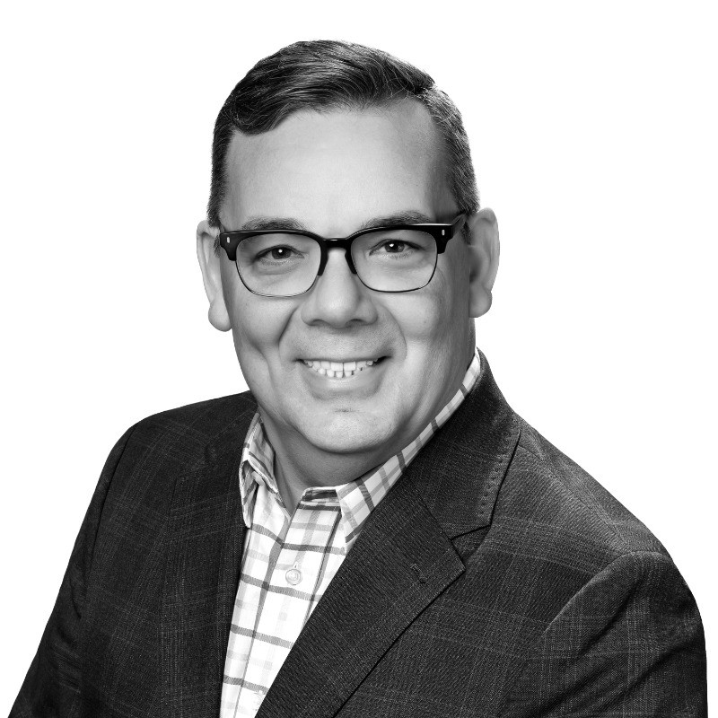
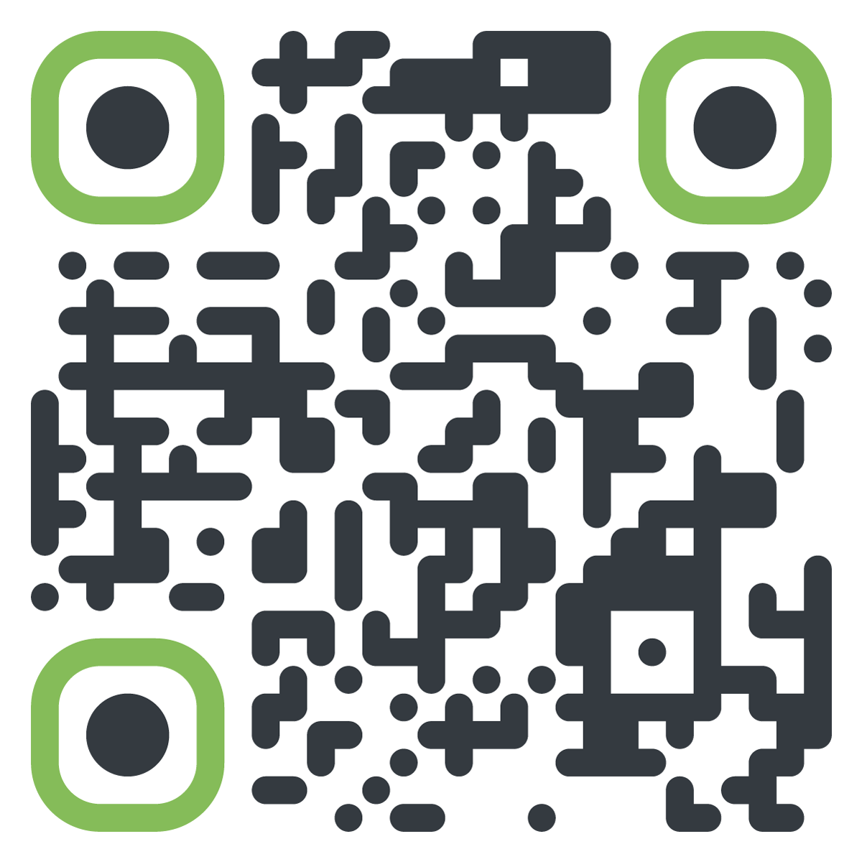
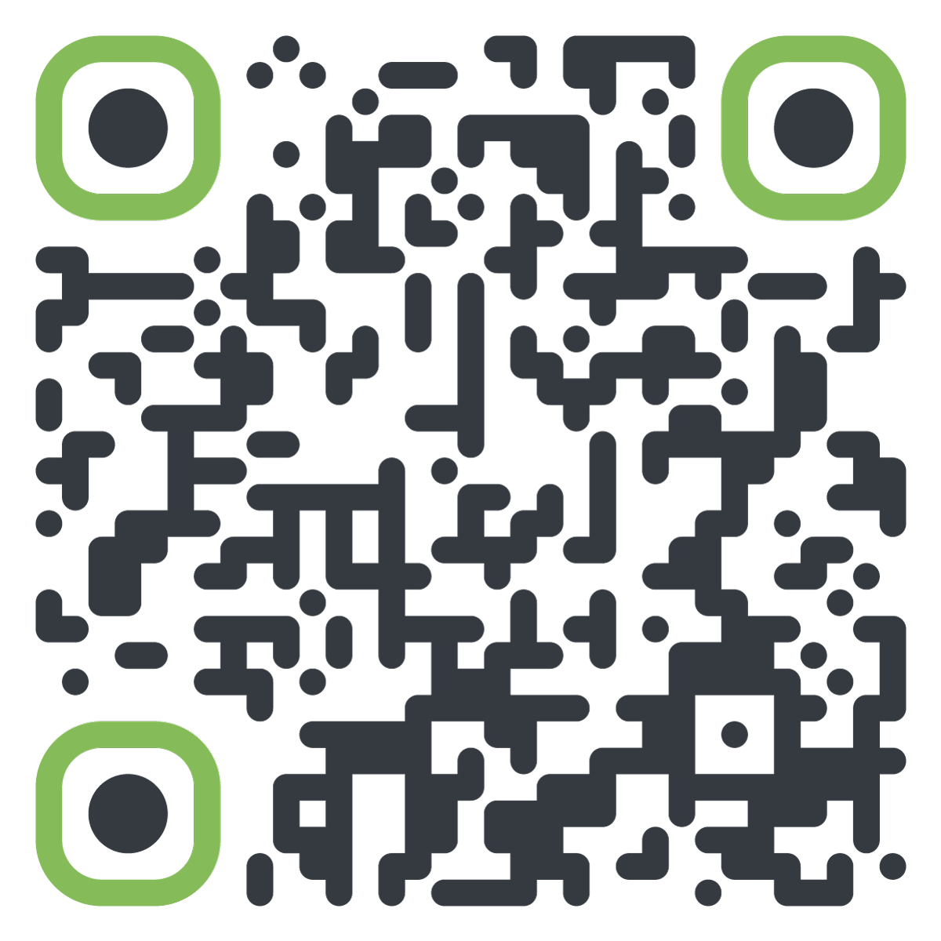
Website
Linkedin
Dr. James Stapleton
President & CEO, codefi,
Managing Director, Innovate SOMO Funds
james@codefiworks.com – 573-979-2149 m
18

Slide 21
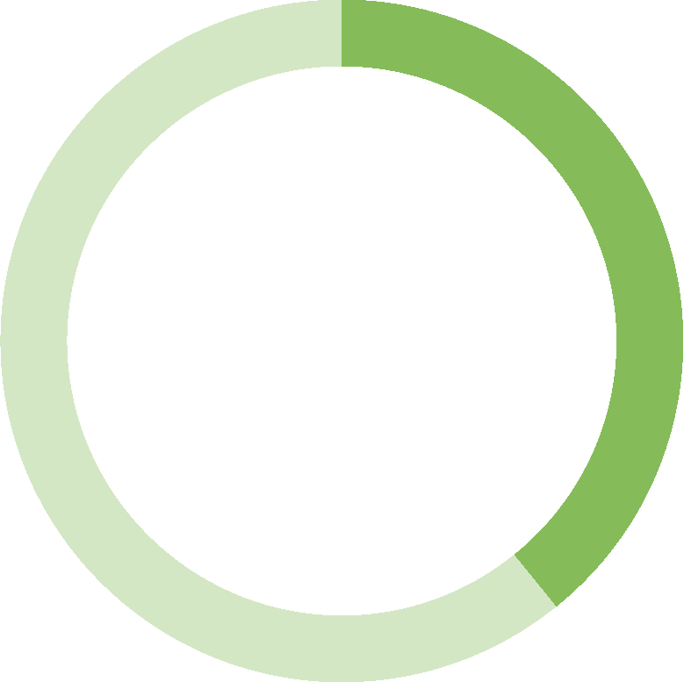
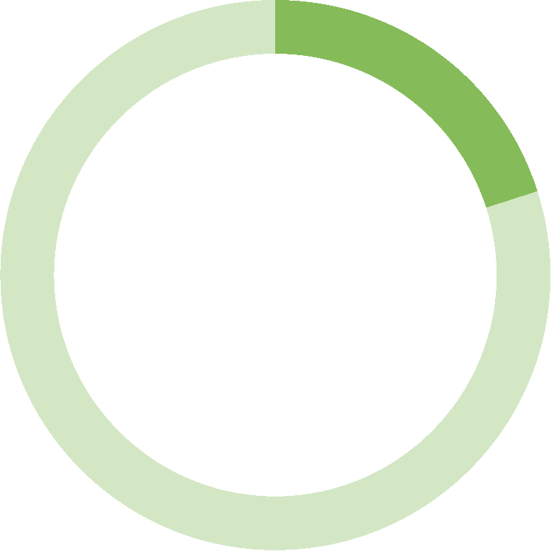
Governance and Structure
Best Practices for Success
Option 1
Option 2
Option 3
PRI program within existing foundation
Subsidiary LLC/LP
Dual structure (501(c)(3) + for-profit fund)
Investment Committee
40%
40%
20%
11
Philanthropic/mission experts
Experienced investors/operators
Sector Domain Experts

Slide 22
Co-Investment Structures
Amplifying Impact Through Leverage
First-Loss Capital
Tiered Returns
Dual Entity
Philanthropy takes first 20-30% of losses
Philanthropy accepts lower returns; private capital gets upside
Nonprofit + for-profit fund working together
The Amplification Effect
Philanthropic Alone
With Co-Investment
8
$0
$1.5M
$3M
$4.5M

