Slide 1
Investing in Rural Prosperity: Building Capacity for Advancing Shared Economic Prosperity
April 11, 2025

Slide 2
The information, analyses, and conclusion set forth are those of the presenters and do not necessarily indicate concurrence by the Federal Reserve Bank of St. Louis, the Federal Reserve Board of Governors, or the Federal Reserve System. Mention or display of a trademark, proprietary product, or firm in the presentation by the author does not constitute an endorsement or criticism by the Federal Reserve System and does not imply approval to the exclusion of other suitable products or services.

Slide 3
Federal Reserve District Map
BOSTON
NEW YORK
PHILADELPHIA
CLEVELAND
RICHMOND
ATLANTA
CHICAGO
ST. LOUIS
MINNEAPOLIS
KANSAS CITY
DALLAS
SAN FRANCISCO
BOARD OF GOVERNORS
BRANCH OFFICES
9I
1A
4D
2B
7G
3C
12L
10J
8H
5E
6F
11K

Slide 4
The mission of Community Development at the Fed:
to promote the economic resilience and mobility of low- to moderate-income and underserved individuals and communities.

Slide 5
Overview
Why rural matters to the Federal Reserve
Key trends in capital investment and capacity
About the Rural Prosperity Initiative
A Framework for Rural Economic Development
What communities can do now

Slide 6
Why Rural Matters to the Federal Reserve
Rural America: A Treasure of Assets
Rural places are critical to the economy
While subject to significant regional variation, the populations of many rural communities are getting smaller, older and more diverse.
Rural communities are more likely to be successful in fostering broad-based economic prosperity if they take an asset-based approach to their development activities.
Picture taken of Breyon Price of Surry County, Virginia, taken from FedCommunities post, Rural America: A Treasure of Assets.
Notes:
https://fedcommunities.org/rural-america-treasure-assets/

Slide 7
Key themes
The distribution of community development capital (CDFI, SBA, CRA Small Business) is uneven across rural areas.
CRA Small Business investment in rural Missouri has been declining, though not by as much as rural areas across the country.
While SBA 7A investment has declined in rural areas nationally, rural Missouri has seen an increase in SBA 7A investment
Out of the top 20 funded issues in Missouri, Education tops the list.
By some measures, remote rural counties have less capacity than other geographic areas.

Slide 8
Rural communities receive fewer CRA small business loan dollars than urban areas
Annual Average CRA Small Business Lending per 1,000 people, 2018 - 2022
Program | Per capita annual average, US urban | Per capita annual average, MO urban | Per capita annual average, US rural | Per capita annual average, MO rural
CDFI | $ 143 | $ 176 | $ 143 | $ 89
SBA 7A | $ 60 | $ 55 | $ 26 | $ 19
CRA Small Business | $ 1,377 | $ 1,484 | $ 678 | $ 623
Source: St. Louis Fed’s Community Investment Explorer
Notes:
In order for a loan, investment or service to be considered as community development activity for CRA consideration, it must provide one or more of the following:
Affordable housing for LMI individuals
Community services targeting LMI individuals
(i.e., childcare, educational services, health services, social services, etc.)
Activities that promote economic development
(i.e., financing small business or farms, and which provide permanent job creation, retention, or improvement for LMI individuals, in LMI geographies, or in geographies targeted for redevelopment (i.e., Empowerment Zones)? Small businesses or farms include those with revenues of $1 million or less or meet the SBA size requirements for Small Business Development Companies or Small Business Investment Companies.)
Activities that revitalize or stabilize LMI geographies, designated disaster areas, and distressed or underserved nonmetropolitan middle-income geographies
(i.e., LMI, distressed, or underserved geographies or designated disaster areas? Must include permanent job creation, retention, or improvement. Activities do not have to be located in an LMI geography, provided you can show that it revitalizes or stabilizes an LMI geography.)
Every bank, regardless of asset size, keeps a CRA public file that can be useful to community-based organizations serving LMI individuals and households in identifying banks in their areas that may be interested in partnerships based on their current plans and programs.
Resources from the Fed:
About the Community Reinvestment Act
The Federal Financial Institutions Examination Council (FFIEC)
Engaging Workforce Development: A Framework for Meeting CRA Obligations
Community Investment Explorer 2.0
Fed Communities - CRA Topics

Slide 9
CRA Small Business investment in rural Missouri has declined
Annual Average CRA Small Business Lending per 1,000 people, 2018 - 2022
Program | 5-Yr Trend, Rural US | 5-Yr Trend, Rural MO
CDFI | +157% | +18%
SBA 7A | -13% | +39%
CRA Small Business | -14% | -9%
Source: St. Louis Fed’s Community Investment Explorer
Notes:
Also, for the trend analysis the CDFI and CRA Small Business compared funding in 2018 to 2022, while the SBA 7A program compares funding from 2019 to 2023.
Community Investment Tool 2.0: https://www.stlouisfed.org/community-development/data-tools/community-investment-explorer

Slide 10
While SBA 7A investment has declined in rural areas nationally, rural Missouri has seen an increase in SBA 7A investment
Annual Average CRA Small Business Lending per 1,000 people, 2018 – 2022, SBA 7A program compares funding from 2019 – 2023.
Program | 5-Yr Trend, Rural US | 5-Yr Trend, Rural MO
CDFI | +157% | +18%
SBA 7A | -13% | +39%
CRA Small Business | -14% | -9%
Source: St. Louis Fed’s Community Investment Explorer
Notes:
Also, for the trend analysis the CDFI and CRA Small Business compared funding in 2018 to 2022, while the SBA 7A program compares funding from 2019 to 2023.

Slide 11
Top 20 issue areas funded in rural Missouri (2014-2018)
Recipient | Amount (US Dollars)
Elementary and secondary education; Botanical gardens; Foundations | $ 12,482,640
University education; Science | $ 9,461,241
NA | $ 3,607,693
Undergraduate education | $ 2,922,200
University education | $ 1,734,866
Residential mental health care; Child welfare | $ 1,517,000
Mental health care; Residential mental health care; Child welfare; Family counseling; Homeless shelters | $ 1,287,100
Human services; Child welfare | $ 1,212,000
Performing arts education; Undergraduate education; University education; Alumni relations; Protestantism | $ 1,138,000
Christianity; Camps; Religion for youth | $ 1,116,730
Elementary and secondary education | $ 891,575
Camps; Religion for youth | $ 740,190
Human services | $ 571,746
Undergraduate education; Academic libraries; Archives and special collections; Catholicism | $ 565,650
Historic preservation | $ 550,042
Presbyterianism | $ 482,000
Education; Community college education | $ 420,000
Protestantism | $ 395,200
Health | $ 325,342
Source: Candid, 2019

Slide 12
Capacity Constraints for Rural Counties
In 2018, only 26% of remote rural counties and 35% of adjacent rural counties have an economic development professional on staff, compared to over half of metro counties.
Governmental capacity depends upon fiscal health – many officials from remote rural and adjacent rural areas report experiencing “moderate” to “significant” levels of fiscal stress.
Photos taken at 2023 Investing in Rural Prosperity Conference in Cape Girardeau. Photo Credit: Corey Woodruff.

Slide 13
What is the Rural Prosperity Initiative?

Slide 14
The Rural Prosperity Initiative is a place-based initiative with a goal to expand community and economic development investment and capacity in rural communities.
Notes:
Rural Prosperity uses existing community assets (people, infrastructure, services, quality of life, etc.) to ensure all members of a community can benefit from development activities.

Slide 15
Helping rural communities navigate their assets and opportunities to achieve economic growth
By utilizing the T-R-I-C (tailored, resilient, inclusive, collaborative) Framework, the initiative will focus on assets/strengths of a community to bring rural leaders together to pursue better economic outcomes for young adults.
Notes:
Current research indicates labor force participation rates, educational attainment, and health status are lagging for young adults in rural areas, which threatens the economic vitality and resilience of rural communities.
With disconnection rates among young adults in our District’s are as high as 16%, and even higher in rural areas (20%), there is a need to catalyze regional action to address youth disconnection and create on-ramps to meaningful employment.
Through a series of convenings, events, and research the initiative will host 8 convenings (2 per region) in 2025 – 2026 and present data and 3 blog posts on rural healthcare workforce and the economy.

Slide 16
Benefits to Participating Communities
Community Action Workshops
Deepening the Data and TRIC to Rural Prosperity
Community Action Workshops will utilize local-level data and assets to create best practices for addressing workforce development challenges for young workers.
Access to Training and Advisement
Opportunities to network with regional and national experts
Community participants have access to engage with CD staff, peer communities, and national leaders on workforce development themes and participate in trainings to support deeper learning and collaboration.
Localized Data and Research
Local data profile and research
Participating communities have access to local-level data and research to assist with community action plans to enhance community capacity and investment.

Slide 17
Research Agenda: Rural Healthcare Workforce and the Economy
Purpose: Expand work that has already been done in healthcare research by CD Research team.
Motives: mental health data was examined and described as an important consideration in workforce participation.
Research Plan:
workforce changes from pre-to post-covid in different healthcare positions
access to mental health resources
the use of AI in workforce hiring and strategic planning.
Notes:
Motives: There are several motives for this line of work. To begin with, in 2024 CD Research blog post, mental health data was examined and described as an important consideration in workforce participation. Expanding on that work, the larger institution of the healthcare industry will be explored.
Research Plan: Quantitative approach. Data was purchased from the American Hospital Association for the years 2019-2023 to dive into three specific topics (1) workforce changes from pre-to post-covid in different healthcare positions, (2) access to mental health resources, and (3) the use of AI in workforce hiring and strategic planning. This data can be disaggregated to share back at the county-level or even smaller.
Potential Timeline: Research is already underway. Results will be distributed through (a) 3 national peer-reviewed publications for each topic contingent on results, (b) 3 district-level blogs on each topic, and then through potential conference work in 2026 such as by establishing healthcare as the theme for the Rural Prosperity conference.

Slide 18
THE TRIC FRAMEWORK

Slide 19
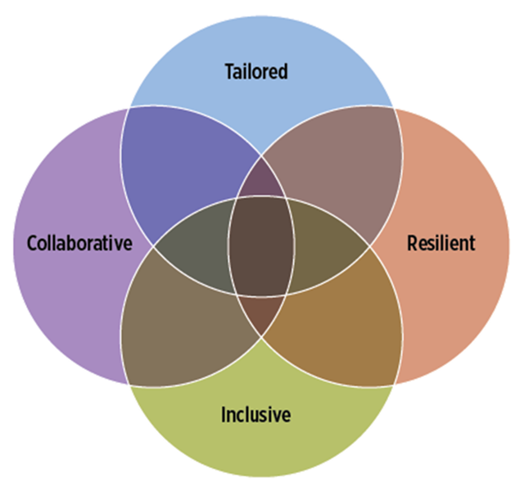
The “TRIC” to shared rural prosperity
Rural communities are more likely to achieve broad-based economic prosperity if they take an asset-based approach to development
To that end, we outline an approach to rural development that is:
T
Tailored
Tailored to the specific goals, assets and organizational infrastructure of the community;
R
Resilient
Designed to be resilient to changing circumstances;
I
Inclusive
Intentionally inclusive about who is at the decision-making table and who benefits from local development; and
C
Collaborative
Created and carried out through a collaborative process
Notes:
Collaborative + Tailored: Rural development is truly tailored when the needs and opportunities of the community are identified through a collaborative process. To be as effective as possible, the partners in any collaboration need to be tailored to the specific community context.
Collaborative + Inclusive: True inclusion is collaborative, in that it involves inviting all groups to the table, listening to their perspectives and incorporating their ideas. The best collaborations are inclusive in that they create shared leadership and power in deciding the path forward.
Collaborative + Resilient: To be truly resilient, a rural development plan must be developed through a collaborative approach so that everyone has a stake in carrying it forward. In addition, the most resilient collaborations are those that intentionally consider how to keep the partners together over time.
Tailored + Inclusive: To be truly tailored, any rural development approach must reflect the goals, skills and talents of all parts of the community. To be truly inclusive, the approach to engaging the community needs to be tailored to the local context.
Tailored + Resilient: Tailoring your approach makes it more resilient because it then reflects the assets, goals and desires of the community. As a result, community members are more likely to see themselves in the plan, increasing the likelihood they take ownership of it and stick with it over time.
Inclusive + Resilient: Resilience necessitates being inclusive so that future community leaders help develop the plan and as a result are committed to it. Furthermore, rural communities cannot be resilient if their most vulnerable residents remain at risk.

Slide 20
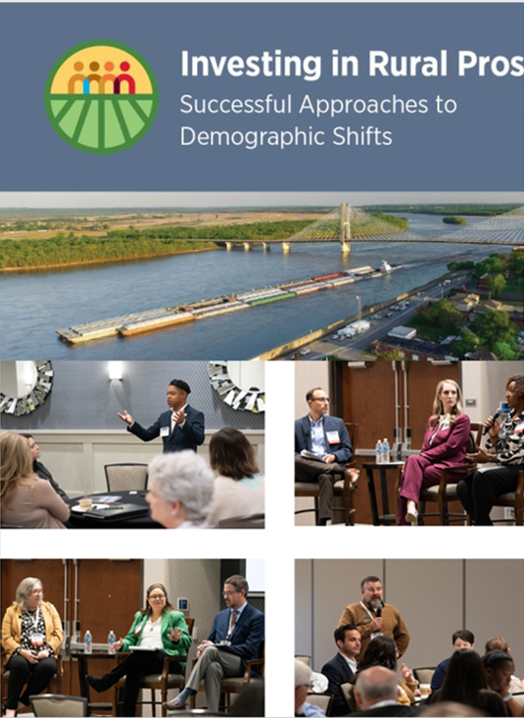
Tailored: Ensuring the Strategy Fits the Place
Attempts to support shared economic prosperity in rural places will be most effective when they are tailored to the specific community in which they are being carried out.
This means the strategy is fashioned around:
The goals of the community
The specific assets present in the community
The community’s organizational capacity
Notes:
Every community has a different history and so has evolved with a unique set of institutions. As a result, the organizations that develop and implement a rural development strategy will likely be different in each community.
Rural development plans that are simply replicated from somewhere else have little chance of being successful, as they are unlikely to closely match the skills, abilities, and interests of community members.

Slide 21
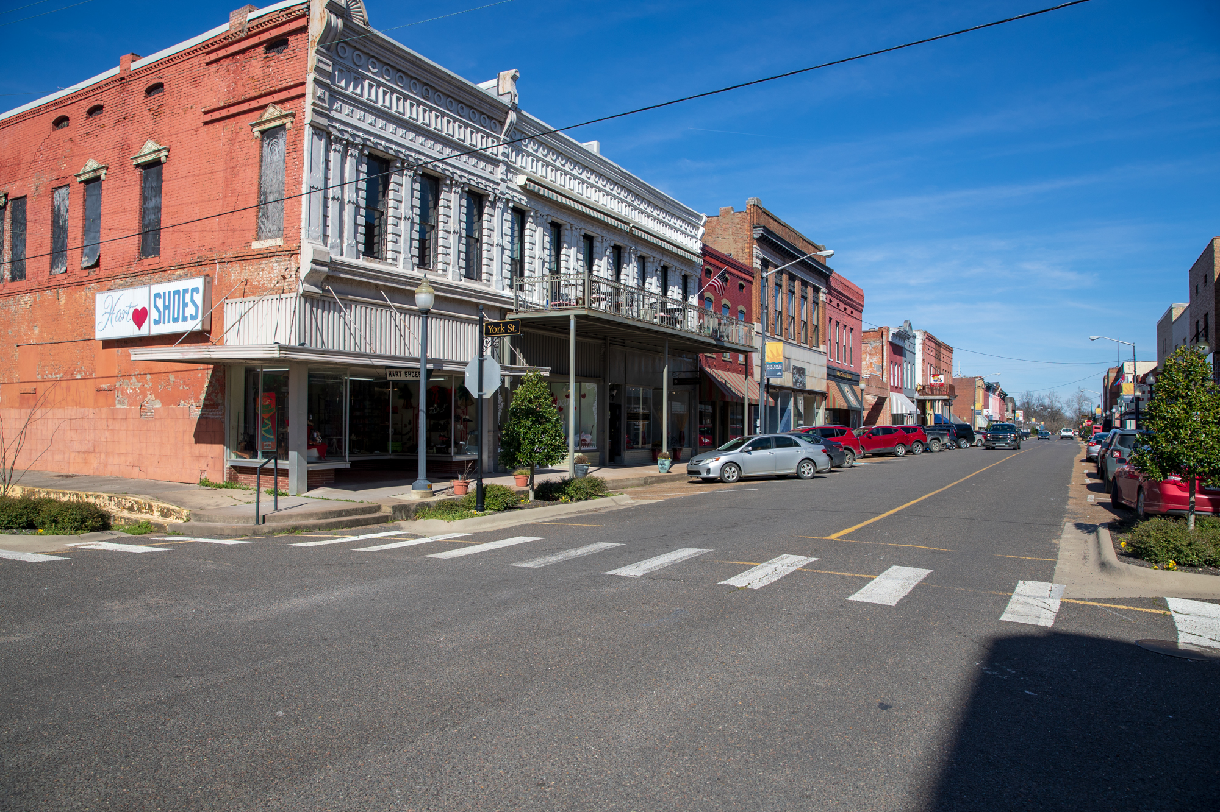
Resilient: Designing for Durable Adaptability
To have long-term, positive effects on the community, rural development efforts must be structured in a way that is resilient to both the sudden shocks and gradual changes that will undoubtedly occur over time.
The changes that may affect a community include but are not limited to:
Widespread or localized economic restructuring
Financial market disruptions
Natural disasters or pandemics
Notes:
Communities should build resiliency into how they plan and structure their development activities. For example, rural development efforts should not be overly reliant on one person, organization or industry.
Rural development strategies should be future-oriented, updated on an ongoing basis, and consistently evaluated to assess their performance.

Slide 22
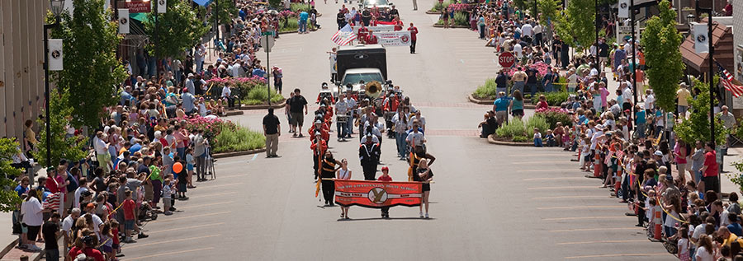
Inclusive: Engaging and Benefiting the Full Community
To advance shared economic prosperity in a rural place, development activities must be inclusive of the full range of people living in the community, especially those who traditionally may be on the sidelines.
Being inclusive means more than just inviting a couple more diverse people into the existing process; it means rethinking your entire approach.
It requires giving traditionally marginalized groups a seat at the table, not only to have their voices heard but to exercise decision-making power.
Notes:
Those on the sidelines of the community are often there because obstacles exist that limit their participation. Therefore, intentionality is required to address the barriers they face and to open the door for new opportunities.
Ensuring everyone benefits from the community’s growth and prosperity will strengthen the community’s fabric and lead to a stronger economy.

Slide 23
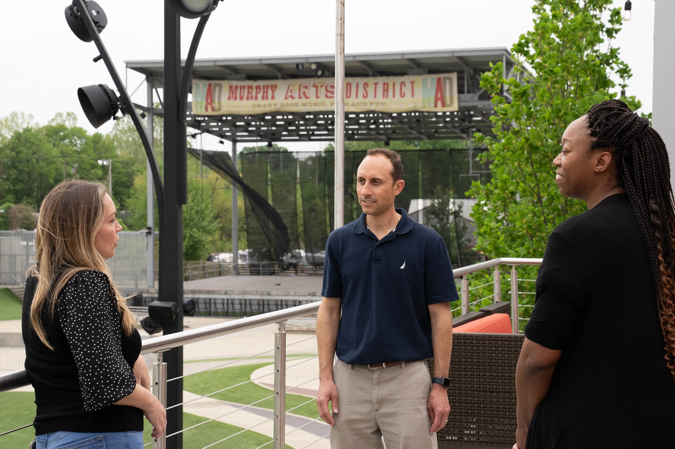
Collaborative: Advancing Further Together
Rural communities are more equipped to advance shared prosperity when people from throughout the community and across the region collaborate to formulate and implement development strategies.
Communities that achieve success over time pursue cross-sector approaches, whereby leaders from the nonprofit, for-profit, financial, government and philanthropic sectors work together.
Even if a rural community works well across sectors within its own borders, it may still struggle to marshal the resources needed to make the most of the opportunities available to it. This is when regional collaboration is necessary.
Notes:
The best collaborations seek to build consensus and employ a distributed leadership approach. Collaborations are more durable when all involved feel their voices are head, respected and given appropriate weight.
Identifying what everyone brings to the table, agreeing on common goals and pursuing a common vision will help make collaboration a reality.

Slide 24
WHAT CAN COMMUNITIES DO NOW TO DEPLOY A SHARED FRAMEWORK?

Slide 25
QUESTIONS TO CONSIDER
Consider your assets
What assets does your community possess?
Invest in long-term human capital investments
Do your policies/initiatives encourage rural communities to invest in long-term, consistent capacity?
Prioritize community input from all voices
Are segments of your community missing from the decision-making table?
Work together
How could you achieve more if you worked together?

Slide 26
For Discussion
Investment and Capacity
Can you describe one or two examples of where philanthropic and public sector stakeholders have collaborated in ways that led to meaningful improvements and investment in workforce development, youth engagement, capacity-building?
Notes:
Can you describe one or two examples of things that have worked well that we might learn from to better understand how to improve rural community and economic development capacity and investment?
Can you describe one or two examples of where philanthropic and public sector stakeholders have collaborated in ways that led to meaningful improvements in rural CED investment?
What are one or two specific outcomes that you would like to see come out of this initiative?
If we have additional time, would like to follow up on the following:
Are there any potential participants who, if they were in attendance, would make participating in an initiative like this especially appealing for you?
What would make participating in an initiative/event like this compelling for you? What would make it worth your time?

