Slide 1

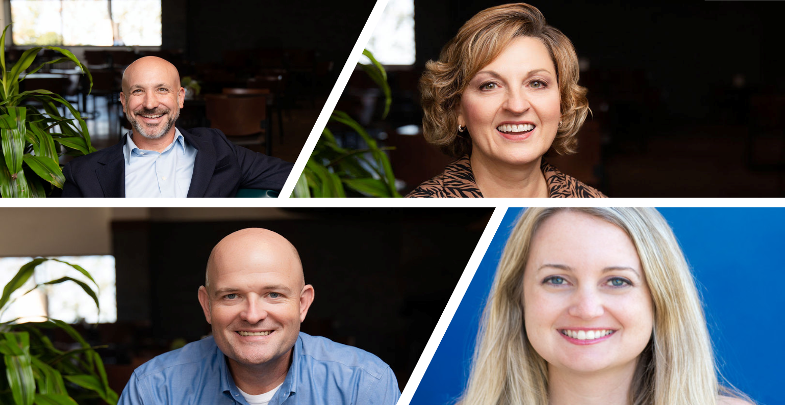


From Conversation to County-Wide Impact
How Partnership Sparked a Literacy Revolution in Phelps County

Slide 2

Phelps County Literacy Initiative

Slide 3

The Spark
One conversation at the Summit
Shared urgency around literacy
Rapid follow-up and alignment

Slide 4
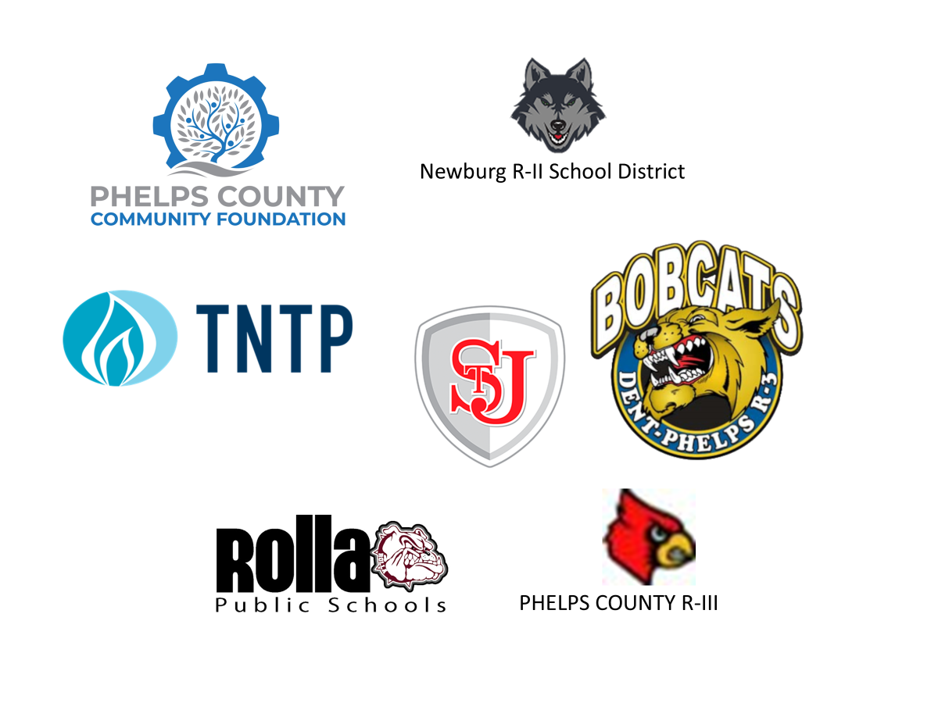
Strategic Partnerships
Aligning Education, Community, and Philanthropy to Drive Outcomes
A cross-sector coalition advancing early childhood, literacy, and workforce pathways across Missouri.

Slide 5
Building Trust
Convened all superintendents
Used interest contracts
Ensured clarity and commitment

Slide 6
Partnership Architecture
Phelps County Literacy Initiative
TKD Foundation leadership
Phelps County CF as connector
TNTP expertise
School district ownership
Funding partner

Slide 7

Missouri Schools
Early Literacy Collaborative

Slide 8
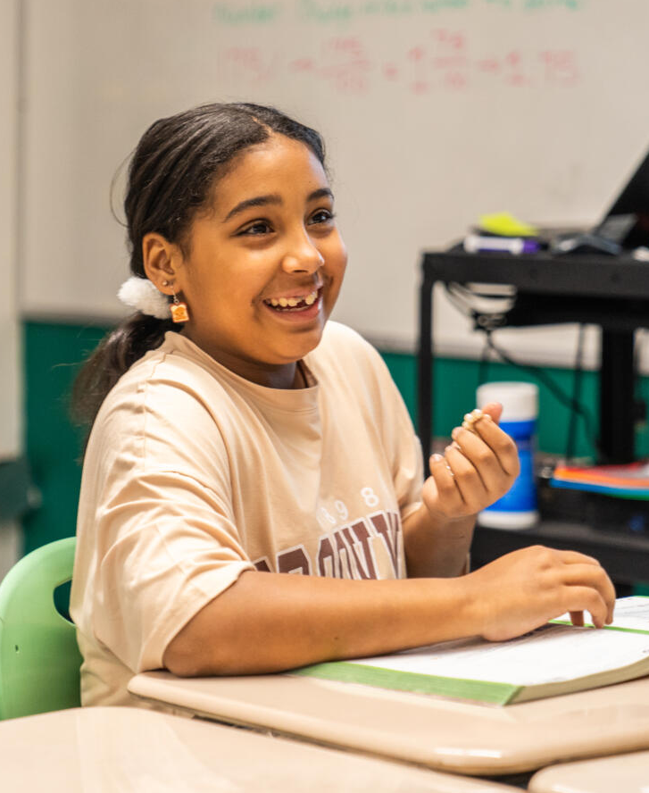
Who We Are
TNTP is a nationally recognized leader in education Combining rigorous research, deep policy expertise, and hands-on consulting to ensure all young people have pathways to economic and social mobility.
A sixth-grade student beams after solving a difficult question.

Slide 9
Catalyzing Change in the Field
Twenty-eight years working inside schools and districts mean we understand how systems work and how change takes hold. Last year alone we partnered with 4,500 districts and 35,000 schools across 39 states, reaching over 18 million students—and we are poised to grow.
Statewide/State Department of Education
School District/CMO
Current TNTP Partners, December 2025

Slide 10
What We Do
Education Consulting
We help school systems strengthen curriculum and instruction, build coherent student experiences, and connect learning to real-world skills and careers—creating learning environments that accelerate academic growth and future readiness.
Research, Policy, and Advocacy
We publish research, shape policy, and advocate for change that ensures all students can access high-quality learning and have multiple pathways to high-wage, in-demand careers.
Leadership Development and Talent Services
We help schools build future-ready teams who can drive instructional excellence, bridge the gap between education and career, and leverage emerging tools to transform outcomes for students.
Community Engagement and Coalition Building
We mobilize stakeholders to take action toward shared goals and build coalitions strong enough to reshape practice, shift policy, and redesign pathways.
Notes:
At TNTP, we operate within a virtuous cycle where our fieldwork informs our research, which, in turn, informs our practice and policy efforts. This continuous loop ensures a dynamic and interconnected approach to our work.

Slide 11

Reading Proﬁciency by Third Grade:
Students reading proficiently by this milestone (3rd Grade) are five times more successful at achieving college and career readiness compared to their non-proficient peers.³
96%
Ninety-six percent of children reading at grade level by the end of 3rd grade graduate from high school on time.
A Critical Milestone

Slide 12
Positive Outcomes
Enhanced Academic Success: Children who read proficiently by third grade are more likely to excel in subsequent academic pursuits.
Higher High School Graduation Rates: Proficient third-grade readers are more likely to graduate from high school on time. Early reading skills set the stage for continued academic engagement and success, reducing the likelihood of dropping out.
Improved Economic Opportunities: Early reading proficiency is linked to better economic outcomes in adulthood. Individuals who develop strong reading skills early are more likely to pursue higher education and secure gainful employment, contributing positively to the economy.
Reduced Risk of Incarceration: There is a correlation between low literacy rates and higher incarceration rates. Ensuring children achieve reading proficiency by third grade can contribute to lower crime rates and reduced incarceration costs in the long term.
https://www.aecf.org/resources/early-warning-why-reading-by-the-end-of-third-grade-matters?utm_source=chatgpt.com
Notes:
Jon

Slide 13

“Reading proficiently by the end of third grade can be a make-or-break benchmark in a child’s educational development.”
- The Annie E. Casey Foundation
75% of students who are poor readers in third grade will remain poor readers.
Third graders who lack proficiency in reading are four times more likely to become high school dropouts.
Educational Attainment - Missouri Department of Corrections (2019)
 | Count | Percent
High School Diploma | 2,777 | 10.9%
9-12th Grade | 3,231 | 12.7%
6-8th Grade | 7,514 | 29.6%
4-5th Grade | 9,223 | 36.3%
0-3rd Grade | 2,669 | 10.5%
Total | 25,414 | 100%
Annie E. Casey Foundation. (2010). Early warning! Why reading by the end of third grade matters. https://assets.aecf.org/m/resourcedoc/AECF-Early_Warning_Full_Report-2010.pdf
Hernandez, D.J. (2012). Double Jeopardy: How Third-Grade Reading Skills and Poverty Influence High School Graduation. Baltimore: The Annie E. Casey Foundation.
Notes:
Jon
What do correlations can you make about the data?
-More than a third of those incarcerated completed 4th or 5th grade….

Slide 14




OUR PROGRAM MODEL
Coach
Monthly coaching, in schools, with a literacy expert and bi-weekly virtual touchpoints.
Cohort
Quarterly virtual learning sessions with a cohort of like-minded teachers and leaders.
Capacity
Building walkthroughs and calibration with school-based administration and the SC RPDC to sustain the work.
Certificate
Partner with Missouri S&T to develop a Literacy Coaching Certificate to help DESE scale the model across Missouri.
Notes:
And this is what our program focuses on – systems of coaching, development, sustainability, and scalability.

Slide 15
Early Literacy Success in Phelps County Districts
As measured by STAR Early Literacy assessment in Newburg, Rolla, and Saint James. As measured by iReady assessments in Dent-Phelps and Phelps
Notes:
Jon
But we found was truly exciting. More than 90% of students grew, scoring higher than their fall STAR and iReady assessments- data that schools are required to submit to DESE.
Districts like Newburg and Dent Phelps – they saw greater student gains then they have ever seen before.
Imagine what would happen if children across Phelps County, year after year, stay at or above grade level.
If these kindergarten, by third grade – are all at or above grade level.
We know that children who are reading on grade level by third grade are:
more likely to meet middle school achievement benchmarks
more likely to graduate from high school on time
less likely to require intensive remediation later
We know that early reading proficiency is strongly associated with improved life outcomes, like postsecondary access, employment stability, and long-term earnings.
Research from the Annie E Casey Foundation*
N size: 385 Dent-Phelps: 19 Kindergarten Newburg: 21 Kindergarten Phelps: 16 Kindergarten Rolla: 235 Kindergarten Saint James: 94 Kindergarten

Slide 16
Early Literacy Success in Phelps County Districts
As measured by STAR Early Literacy assessment in Newburg, Rolla, and Saint James. As measured by iReady assessments in Dent-Phelps and Phelps
Notes:
Likewise, first grade students across Phelps County made impressive gains too.
And at the end of this school year, we are excited to see further progress.
N size: 385 Dent-Phelps: 28 1st Graders Newburg: 23 1st Graders Phelps: 24 1st Graders Rolla: 240 1st Graders Saint James: 70 1st Graders
385

Slide 17
Early Impact
Rapid K–1 reading gains
Instructional consistency
Teacher adoption

Slide 18
Sustainability
Capacity over programs
Philanthropy as partner
Scalable model

Slide 19


Key Takeaways
Relationships drive change
Alignment is critical
Invest in capacity
Focus on early literacy

Slide 20
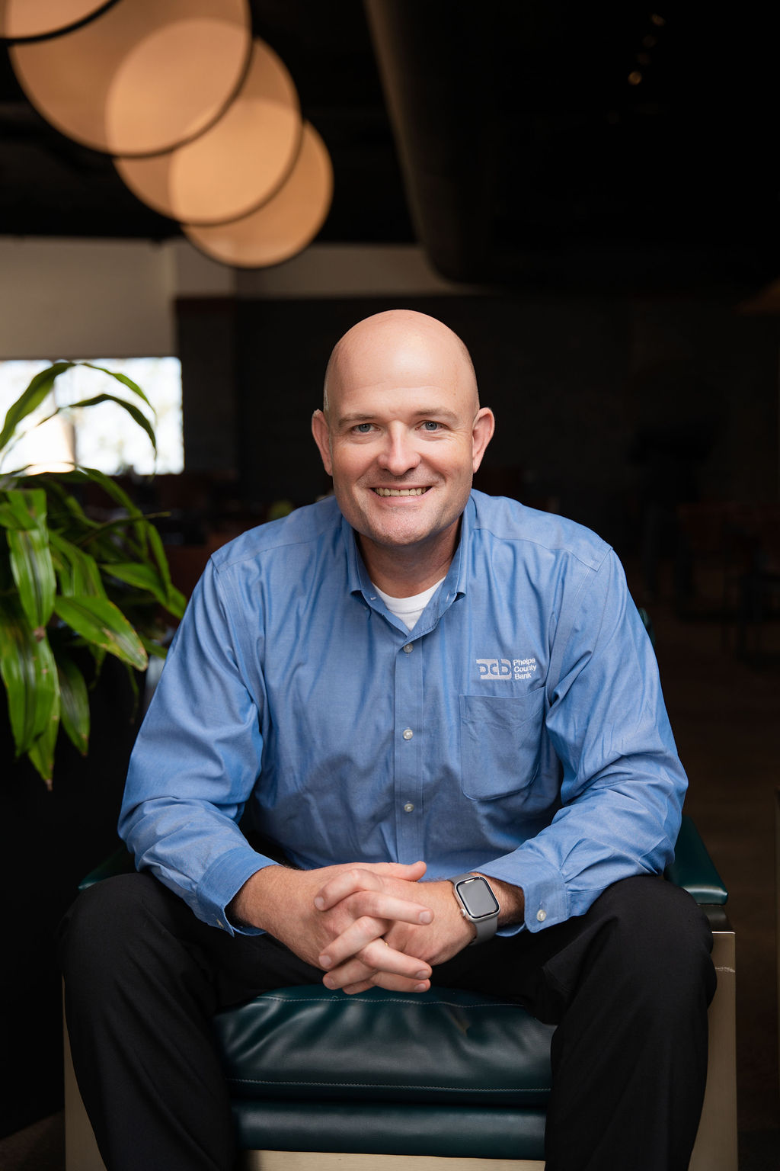
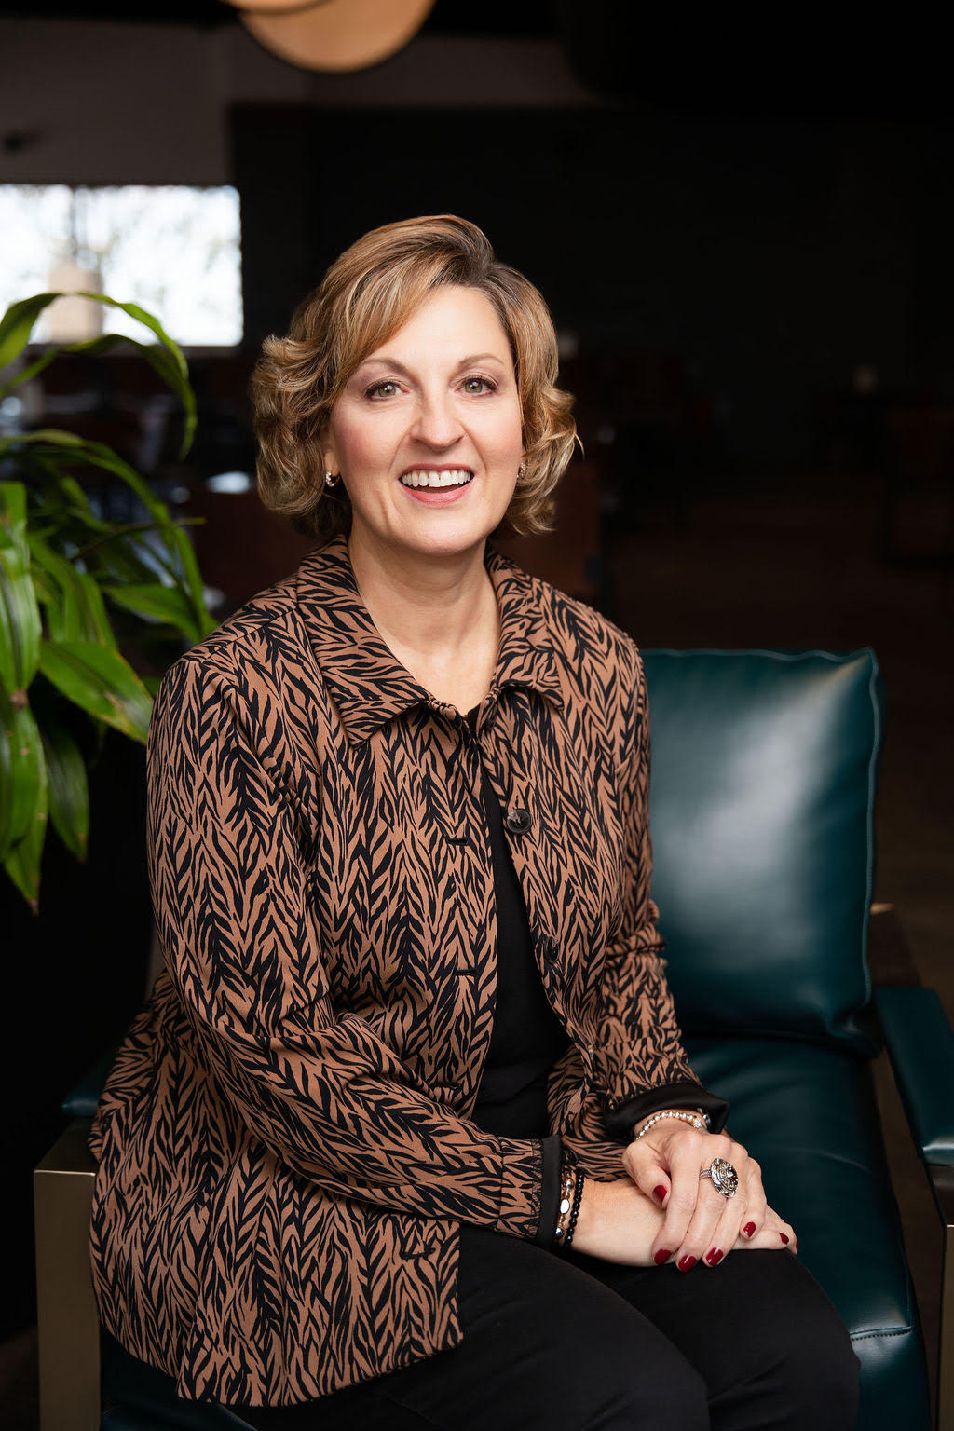
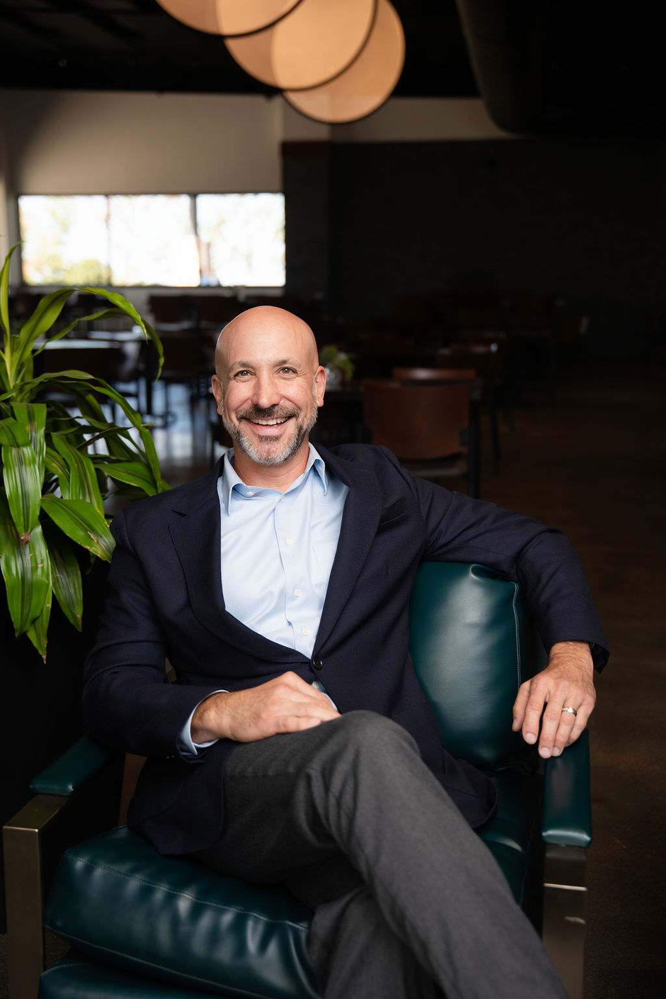
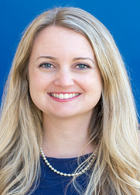
Connect with Panelists
For follow-up or partnership questions
Ben Tipton
Kim Day
President/CLO Phelps County Bank
Chair, Phelps County Community Foundation
Cofounder and President, TKD Foundation
Treasurer, Phelps County Community Foundation
ben.tipton@mypcb.com
kimdavisday@gmail.com
John Money
Kim Davidson
SVP HR and Philanthropy, Phelps Health
Director, TNTP
jmoney@phelpshealth.org
kim.davidson@tntp.org
(573) 458 - 7547
Notes:
[Sources] - User-provided text, logos, photos, and imagery from the uploaded PowerPoint deck.

Slide 21


Visit Us Online
www.phelpscountycommunityfoundation.org
www.tntp.org

