Slide 1
Aging in Rural Communities: Opportunities to Thrive
Rural Philanthropy Summit

Slide 2
Welcome!
The Aging Landscape in Missouri
Value of Field Building and Coming Together
Solutions
Issues Rural Older Adults Face
Notes:
Solutions that make our communities a place for all to age well.

Slide 3
Aging in

Slide 4
Aging Landscape in Missouri (snapshot)
Rural America is grayer than the rest of the nation
Rural older adults want to remain in their homes for as long as possible
Rural older adults have less access to health care and long-term supports (i.e. caregiving)
Notes:
Over 1 in 4 Missourians will be 60+ by 2030, but rural counites are grayer than the state as a whole with some counties in MO representing almost 40% of the county population as 60 and over.
According to an AARP poll 90% older adults want to remain in their homes for as long as possible. Like older adults across the country, rural seniors tend to want to age in their communities, amid familiar people and places. And data confirms this with only 5% of older adults living in nursing homes.
But with fewer health care providers, fewer professional caregivers, and fewer young people than in urban areas, rural communities struggle to care for aging residents.
On average, rural residents travel twice as far as urban residents to reach medical or dental care.
•There are 10.9 physicians per 100,000 people in rural areas vs. 31.7 in urban areas.
In rural communities, where the nearest hospital, clinic, or nursing home can be miles away, health and human service organizations often fill gaps.

Slide 5
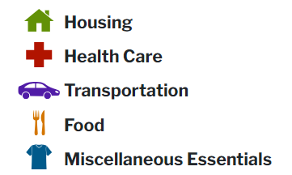
Elder Economic Index
It includes the cost of:​
The Elder Index is specific to
household size
location
housing tenure
health status
Developed by the Gerontology Institute at the University of Massachusetts - Boston
Notes:
The Elder Economic Security Standard™ Index (Elder Index), was developed by the Gerontology Institute at the University of Massachusetts Boston.
The Elder Index is a measure of the income that older adults need to meet their basic needs and age in place with dignity. The Elder Index is specific to household size, location, housing tenure, and health status. It includes the cost of: housing heath care, transportation food and miscellaneous essentials

Slide 6
Information Adapted from Jan E. Mutchler, PhD at University of Massachusetts Boston and www.ElderIndex.org
Notes:
The Elder Index measures the income older people need to meet their daily living expenses while staying independent in their own homes.
Built around a market basket of everyday expenses encountered by people 65+
•Bare bones budget
•Assumes living independently
•Paying for everything out of pocket , no subsidies
Go thru slide
National averages suggest that 48% of older adults living alone and 21% of older couples have annual incomes below the Elder Index value. In every state, more than one-third of older singles are at risk of being unable to afford basic needs and age in their own homes.

Slide 7
Information Adapted from Jan E. Mutchler, PhD at University of Massachusetts Boston and www.ElderIndex.org

Slide 8
Information Adapted from Jan E. Mutchler, PhD at University of Massachusetts Boston and www.ElderIndex.org

Slide 9
Visit www.ElderIndex.org to:
Look up and compare county, state, and national Elder Index values.
View monthly and annual Elder Index values by housing type, household size, and health status.
View breakdown of cost components.
Download charts and tables for specific locations.
Notes:
Visit www.ElderIndex.org to:
Look up and compare county, state, and national Elder Index values.
View monthly and annual Elder Index values by housing type, household size, and health status.
View breakdown of cost components.
Download charts and tables for specific locations.
The Elder Index can be a powerful tool for state and local advocates and aging service providers to educate policymakers, donors, and funders about the economic realities that older adults face.

Slide 10
Area Agencies on Aging (AAAs)
Notes:
AAAs primary goals are to help older adults remain in their homes for as long as possible with dignity, as well as to provide support for their caregivers. They provide a wide variety of programs, which vary heavily from agency to agency. These include services related to nutrition (like home delivered or congregate meals), transportation, information and assistance, caregiver support and more.

Slide 11
Silver Haired Legislature

Slide 12
Long Term Care Ombudsman

Slide 13
Centers for Independent Living

Slide 14
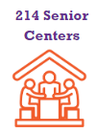
Senior Centers

Slide 15
Advocacy Groups
Notes:
We have several different organizations that provide advocacy for policy changes for older adults and their caregivers here in Missouri. These are household names that you may know such as American Association of Retired Persons known as AARP and The Alzheimer’s Association. Advocates are working to push for policies that benefit older adults within the statehouse as well as some provide education and direct services to older adults such as assistance seeking employment, caregiver support grants, and many more programs.

Slide 16
Various Non-Profits

Slide 18
Coming Together: Field Building
Notes:
-As you can see, funding has been decreasing at our state level and we have hundreds of players who want to help older adults thrive here in Missouri which is a fantastic thing, but what could it look like if we all came together? It would be foolish to think that one organization or even type of the organization that I mentioned alone can fix every single problem related to aging in Missouri. But the fact of the matter is that’s the approach we’ve been thus far. Each different party siloed away with a little bit of collaboration here and there, but it’s been a slow process to get much meaningful change made at the state level especially when it comes to making sure that older adults are included in the state budget.
That’s why field building is crucial. Field building is a coalition-based approach to making complex social changes come to fruition. This involves activities aimed at developing, aligning, or expanding the work of multiple actors to advance broad outcomes in a specialized area of practice.
Now let’s take a look together at the phases of building a field. This process ebbs and flows a lot and sometimes growth within the field-building process is more linear than not.

Slide 19
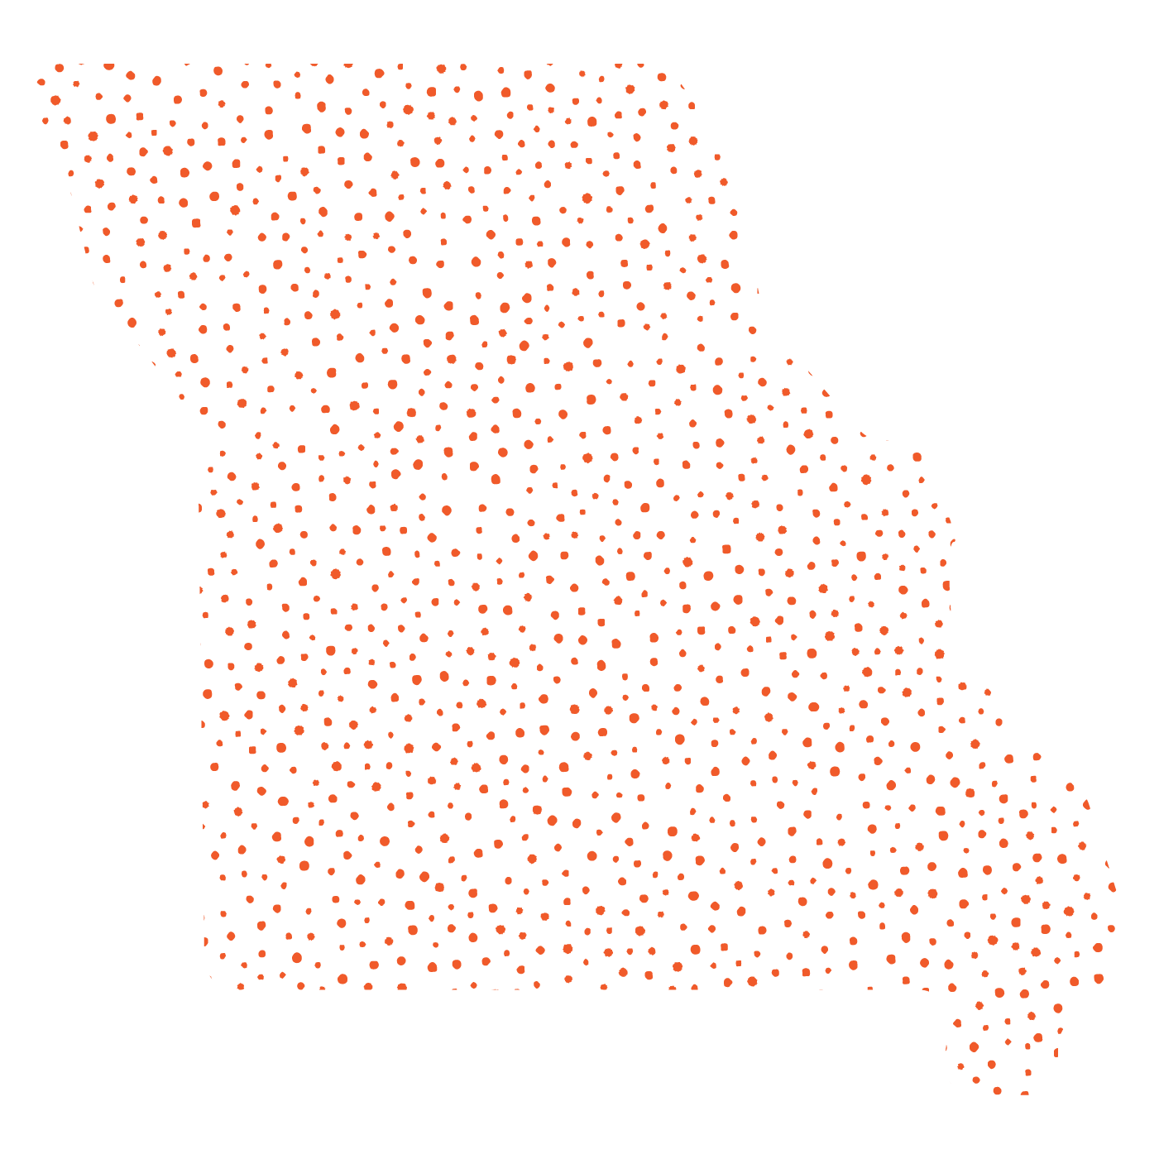
The Aging Network Builds A Field
Emerging
Forming
Evolving
Source: Adapted from The Bridgespan Group

Slide 20
Meet Missouri Council on Aging

Slide 21
Received inaugural funding for launching the Council’s work

Slide 22
Together, we are educating and advocating for programs and policies that improve the lives of Missourians as we age. You can join us on our mission.
Missouri Council on Aging
THE MISSION

Slide 23
Missouri Council on Aging
Think big about aging in Missouri. .
Building and Advancing a Field of Advocates
Promote the full story of aging
Establish a robust, cross-sector, multidisciplinary coalition
Amplify the collective needs of older adults in Missouri

Slide 24
Connecting organizations to build a field of advocacy for older adults in Missouri.
Missouri Council on Aging
Bi-Weekly Advocacy Calls
Network Education/Training
Legislative Engagement and Education
Host statewide coalition of organizations to learn about legislative activities and opportunities for advocacy.
Bi-weekly during MO Legislative Session (January-May)
Provide coalition training on a variety of trends and topics.
Create awareness and educational campaigns to help inform MO Legislators on the statewide aging landscape.
Notes:
Ware out there meeting state legislators to educate them about what is going on within the aging field and the issues that matter to older adults. We are currently in the midst of collecting answers for our Missourians Age Well campaign. We have lots of exciting work coming up that I can’t share quite yet, but right, we are in the midst of finalizing our inaugural policy priorities and we’re excited to share the agenda soon!

Slide 25
Missourians, Age Well
One Simple Question:
How can Missourians age well?
Any Missourian can answer this question by clicking here

Slide 26
Issues Facing Rural Older Adults

Slide 27
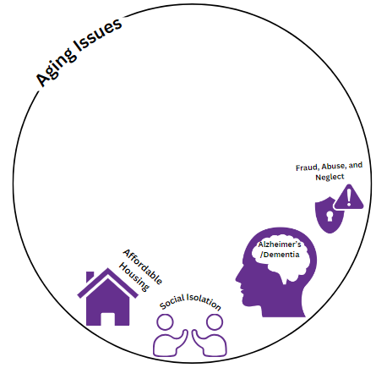
Notes:
Social Isolation

Slide 28
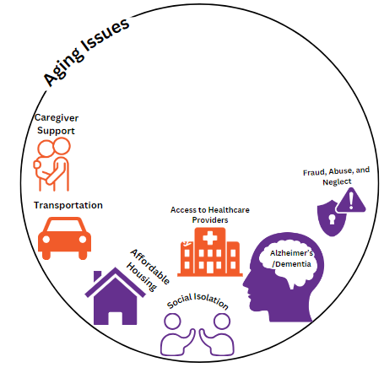

Slide 29
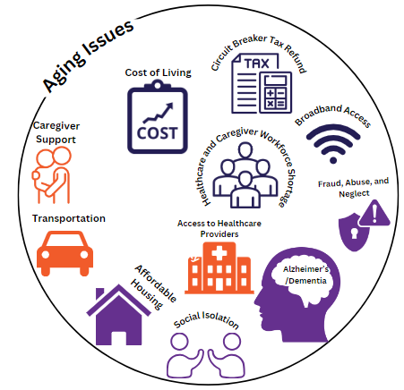

Slide 30
Solutions?

Slide 31
67.990. Senior Citizens’ Services Fund Tax
The governing body of any county or city not within a county may, upon approval of a majority of the qualified voters of such county or city voting thereon, levy and collect a tax not to exceed five cents per one hundred dollars of assessed valuation, or in any county of the first classification with more than eighty-five thousand nine hundred but less than eighty-six thousand inhabitants, the governing body may, upon approval of a majority of the qualified voters of the county voting thereon, levy and collect a tax not to exceed ten cents per one hundred dollars of assessed valuation upon all taxable property within the county or city or for the purpose of providing services to persons sixty years of age or older. The tax so levied shall be collected along with other county or city taxes, in the manner provided by law. All funds collected for this purpose shall be deposited in a special fund for the provision of services for persons sixty years of age or older, and shall be used for no other purpose except those purposes authorized in sections 67.990 to 67.995. Deposits in the fund shall be expended only upon approval of the board of directors established in section 67.993, if in a county, and only in accordance with the fund budget approved by the county governing body.

Slide 32
Atchison
Worth
Mercer
Putnam
Schuyler
Scotland
Clark
Nodaway
Harrison
Gentry
Grundy
Sullivan
Adair
Knox
Missouri Senior Levies
Holt
Andrew
Daviess
Lewis
DeKalb
Linn
Macon
Livingston
Shelby
Marion
Buchanan
Clinton
Caldwell
Ralls
Platte
Carroll
Chariton
Randolph
Monroe
Clay
Ray
Pike
Saline
Howard
Audrain
Jackson
Lafayette
Boone
Montgomery
Lincoln
Cooper
Callaway
Warren
Cass
Johnson
Pettis
St. Charles
Moniteau
St. Louis County
St. Louis City
Morgan
Cole
Osage
Gasconade
Franklin
Bates
Henry
Benton
Jefferson
Miller
Maries
St. Clair
Hickory
Camden
Crawford
Washington
Vernon
Pulaski
Phelps
St. Francois
Ste. Genevieve
Cedar
Polk
Dallas
Laclede
Dent
Iron
Perry
Barton
Dade
Reynolds
Madison
Cape
Girardeau
Greene
Webster
Wright
Texas
Shannon
Bollinger
Jasper
Lawrence
Christian
Wayne
Scott
Newton
Douglas
Carter
Stoddard
Mississippi
Barry
Howell
Butler
New Madrid
McDonald
Stone
Taney
Ozark
Oregon
Ripley
Dunklin
Pemiscot

Slide 33
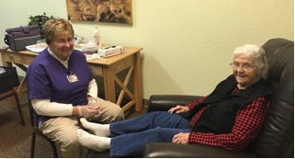
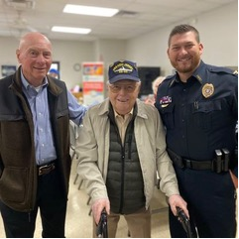
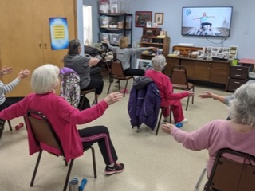
Christian County Senior Services Tax Fund

Slide 34
Funder Solutions
Find local leaders and invest in developing them
Support local levy funds getting put on the ballot
Forming a funder collaborative
Support advocacy and policy change at the state and local level

Slide 35
An Overview
Participated in Missourians, Age Well campaign
Learned about an Overview of the Aging Landscape in MO
Discussed the power of field building and coming together
Learned about local solutions to come together about aging issues

Slide 36
Connect with Us!
Reach out via email to any of us:
jopsal@stlseniorfund.org
bridget@missouricouncilonaging.org
billdebi76@suddenlink.net

